Slide 1
A Demand Gen Playbook for Today’s Dynamic Market Conditions
Craig Rosenberg, Mini Peiris
July 28th, 2023

Slide 2

We help our portfolio build and optimize hyper-growth GTM machines

Slide 3
















The GTM platform leverages our expert network to provide a suite of offerings
Educational / Networking Events
Advisory
Content
GTM
Network
Experts in sales and marketing across the startup growth lifecycle

Slide 4
Today’s Agenda
30 mins : GTM Playbook Insights - Scale Team: Craig Rosenberg, Mini Peiris
60 mins : 1H Performance vs. 2H Plans - Member Share
Elle Woulfe - Formstack
Ari Rosenstein - Techsee
Beth McCullough - Drone Deploy
Mike Stearns - CircleCI
Brandee Sanders - Observe.ai
30 mins : Open Forum / Discussion

Slide 5

Dynamic Market with Headwinds
…where the only constant is CHANGE
Requires:
A new GTM playbook
Constant review of results
Rapid iteration as needed
Led us to field a Demand Programs survey on the hypothesis that companies were making significant adjustments in what they would Stop, Start & Continue
Notes:
Revenue target alignment + key metrics like ACV, Funnel Conversion, Marketing Contribution to Pipe
Make sure Finance doesn’t dictate budget prematurely
Joint collaboration: Finance, Sales, Marketing
Finance tells you what budget should be w/o bottom up plan
All parties need to operate as one and off the same numbers– can’t have separate convos between rev ops, finance, marketing etc.

Slide 6















Survey Sez…
Sign of the Times
82% of programs “continue” but most don’t require budget / leverage existing resources
Surprise
Not as many “stops” as expected given budget headwinds
Marketers report only planning to cut 5.1% of their programs

Slide 7

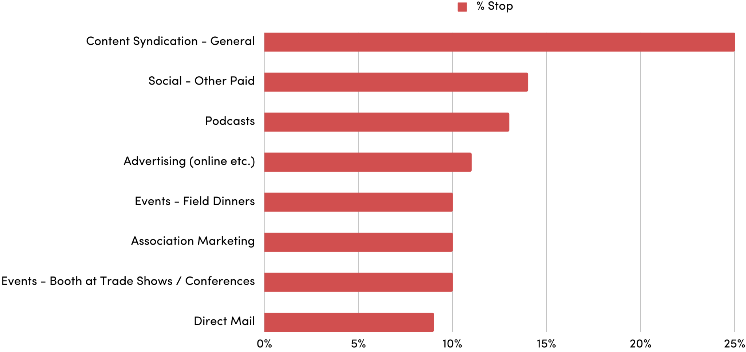
Leading the pack for STOP
CAVEAT: Low absolute #s on some of the responses
25%
14%
13%
11%
10%
10%
10%
9%

Slide 8
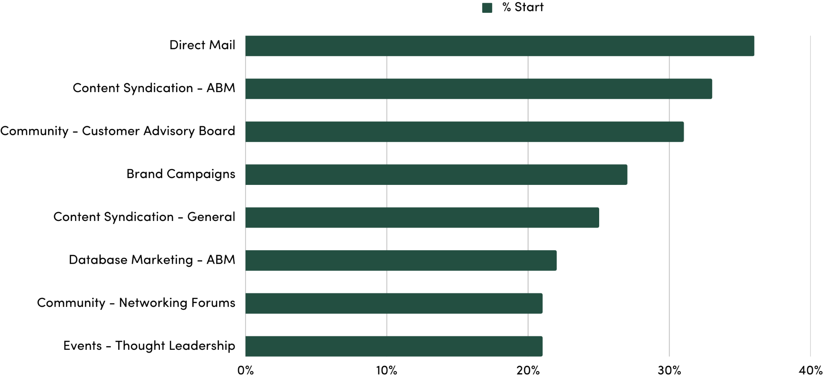
Top of the START hit parade
36%
33%
31%
27%
25%
22%
21%
21%

Slide 9

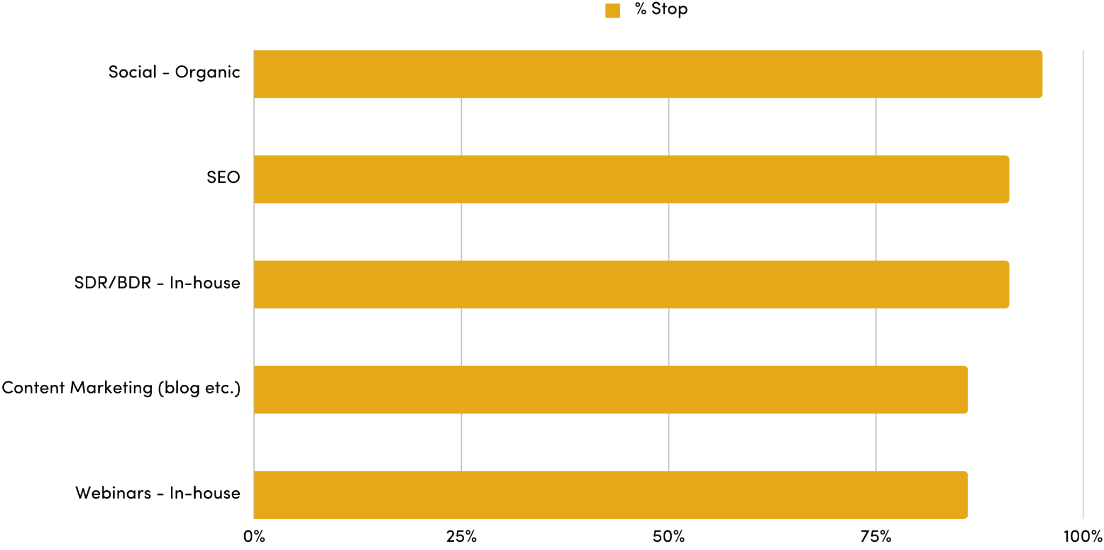
SO much on the CONTINUE list beyond these top 5
95%
TIED FOR 6th:
Social - LinkedIn Paid
Videos (testimonials, brand etc.)
Events - Booth at Trade Shows / Conferences
Database Marketing - Nurture
95%
91%
86%
86%

Slide 10
Elle Woulfe, SVP Global Marketing
STOP/START/CONTINUE: Using 1H Learnings to Set 2H Program Plan
STOP
Events in general - particularly Dreamforce sponsorship & SFDC Partner events
Pure brand marketing - podcast, awareness blogs/ TOFU content, “proactive” social media engagement
Acquisition experiments
Lower converting programs & campaigns
SDR outbound
START
Hyper alignment with sales teams & motions
Product Led Sales / ABM expansion plays
Verticalized marketing plays
Personalized lifecycle marketing
Automation & scaling for lead handling & follow up
CONTINUE
Content Marketing / Social Media, but changing our approach to committee based content development, ruthlessly aligned to quarterly themes
PLG Growth experiments
Scoring refinements to drive greater lead handling efficiency
Very product-centric demand campaigns
SEM / SEO aligned to acquisition & ROI targets
Notes:
Revenue target alignment + key metrics like ACV, Funnel Conversion, Marketing Contribution to Pipe
Make sure Finance doesn’t dictate budget prematurely
Joint collaboration: Finance, Sales, Marketing
Finance tells you what budget should be w/o bottom up plan
All parties need to operate as one and off the same numbers– can’t have separate convos between rev ops, finance, marketing etc.

Slide 11
Ari Rosenstein, VP Marketing
STOP/START/CONTINUE: Using 1H Learnings to Set 2H Program Plan
STOP
3rd party webinars
Trade show booths
Direct Mail
Paid Social…
START
Videos, videos, videos
AI assisted efforts
AI BDRs
AI Generated Messaging
AI Image creation
Retargeting
CONTINUE
SEO
Content Marketing
Targeted events for booking meetings
Partner generated pipeline enablement
Notes:
Revenue target alignment + key metrics like ACV, Funnel Conversion, Marketing Contribution to Pipe
Make sure Finance doesn’t dictate budget prematurely
Joint collaboration: Finance, Sales, Marketing
Finance tells you what budget should be w/o bottom up plan
All parties need to operate as one and off the same numbers– can’t have separate convos between rev ops, finance, marketing etc.

Slide 12
Beth McCullough, Sr. Director Demand Gen
STOP/START/CONTINUE: Using 1H Learnings to Set 2H Program Plan
STOP
Partner Marketing
SEO (Website Migration)
Email Blasts
Google Ads (to every industry and sub-industry)
START
Brand Campaign
Direct Mail
Events - Field Dinners
Integrated ABX Campaigns
Community - Networking Forum
Face to Face Customer Meetings
CONTINUE
Advertising (Targeted)
Community - CAB
Community - Support Forum
Database Marketing - ABM
Events - Tradeshows
Events- Pre-set meetings
Podcasts
SDR/BDR - In-house
Webinars - 3rd Party & In-house
SEM/Paid Search
Social - Organic
Social - LinkedIn Paid
Videos
Notes:
Revenue target alignment + key metrics like ACV, Funnel Conversion, Marketing Contribution to Pipe
Make sure Finance doesn’t dictate budget prematurely
Joint collaboration: Finance, Sales, Marketing
Finance tells you what budget should be w/o bottom up plan
All parties need to operate as one and off the same numbers– can’t have separate convos between rev ops, finance, marketing etc.

Slide 13
Mike Stearns, VP Demand Gen
STOP/START/CONTINUE: Using 1H Learnings to Set 2H Program Plan
STOP
Inefficient spend (CAC/LTV)
Trade show booths (cutting half)
Video
Display
Content Syndication
START
Direct Mail
New Acquisition Strategy
Outsource Int’l SDR
Startup Programs
Personalization
CONTINUE
SEO
Field Events - Dinners
Case Studies
Social Organic
DevRel Community
Account Based Everything
CAB
PLG
Internal SDR outbound
Notes:
Revenue target alignment + key metrics like ACV, Funnel Conversion, Marketing Contribution to Pipe
Make sure Finance doesn’t dictate budget prematurely
Joint collaboration: Finance, Sales, Marketing
Finance tells you what budget should be w/o bottom up plan
All parties need to operate as one and off the same numbers– can’t have separate convos between rev ops, finance, marketing etc.

Slide 14



Brandee Sanders
VP Demand Gen + Marketing + Brand
STOP/START/CONTINUE: Using 1H Learnings to Set 2H Program Plan
Summer 2023

Slide 15
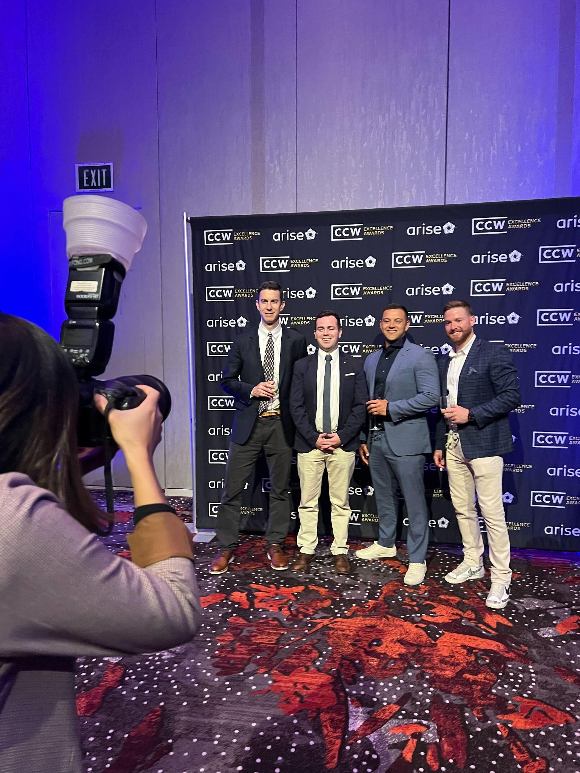
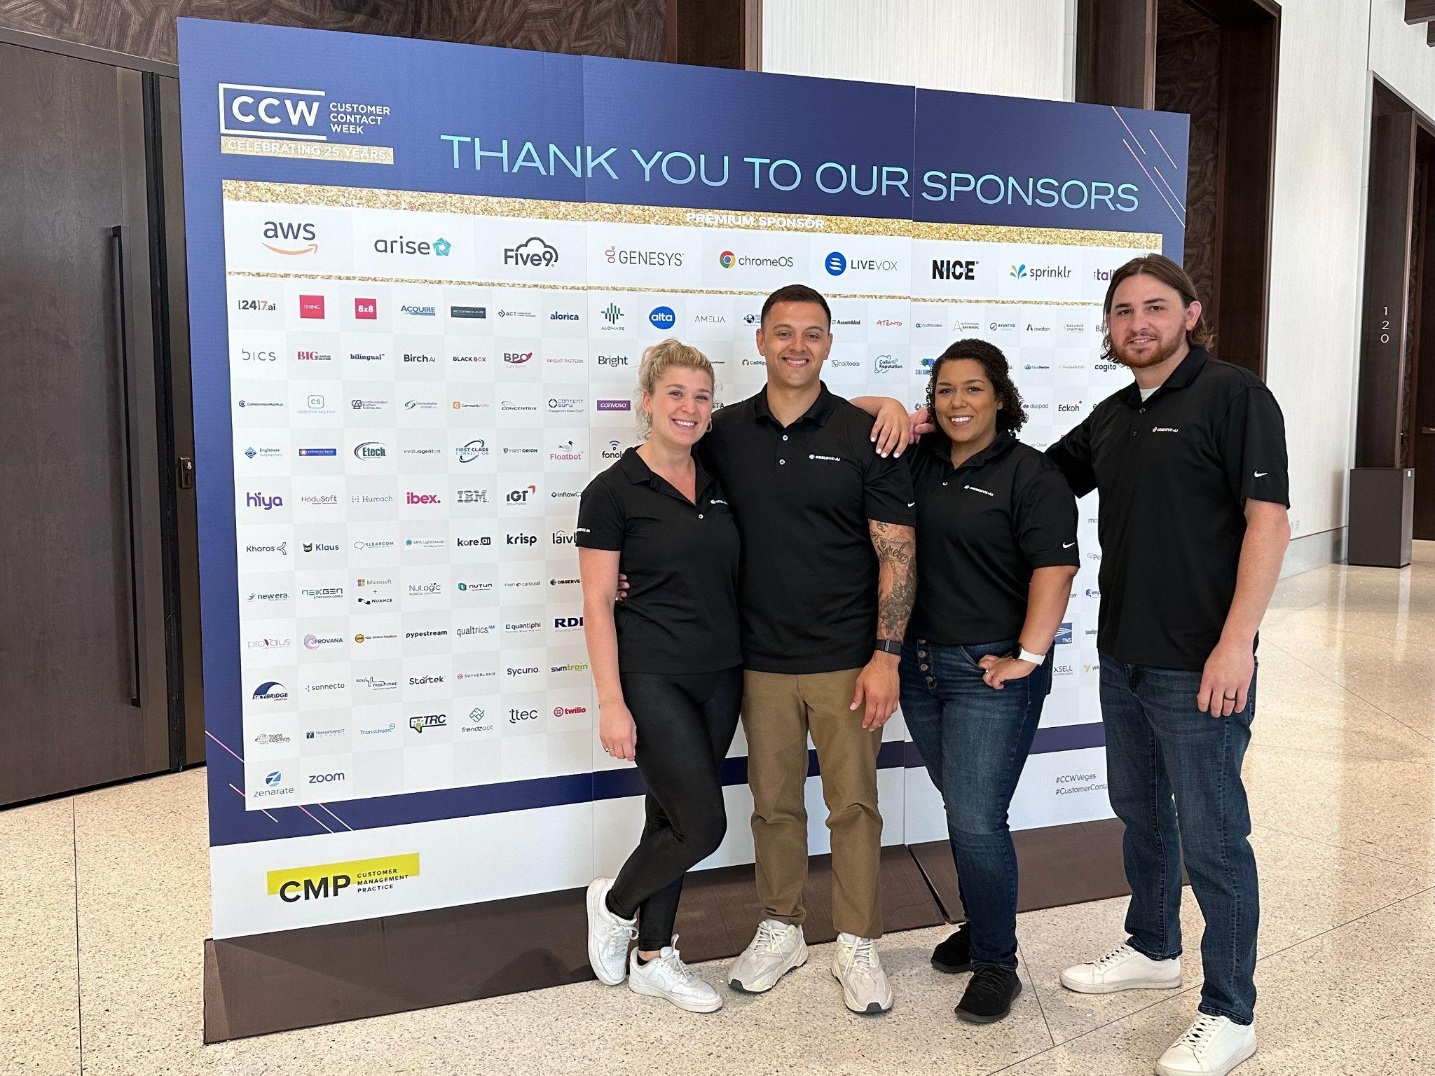
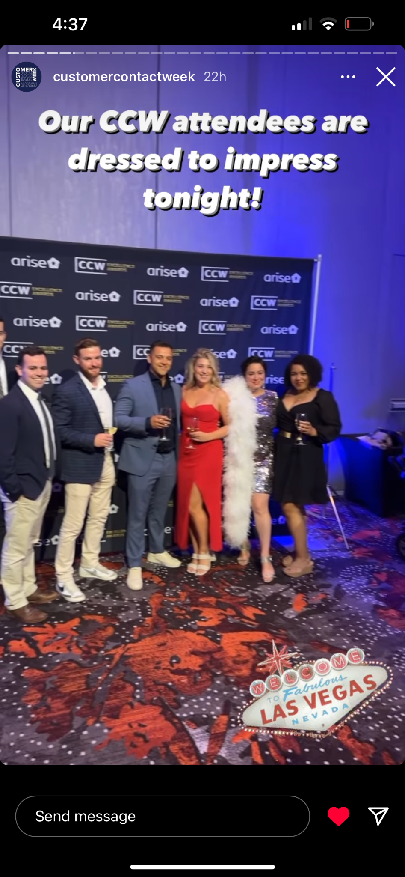
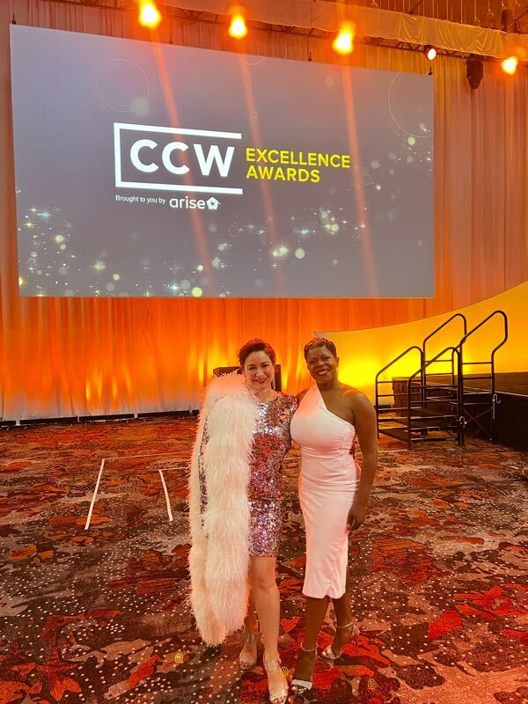
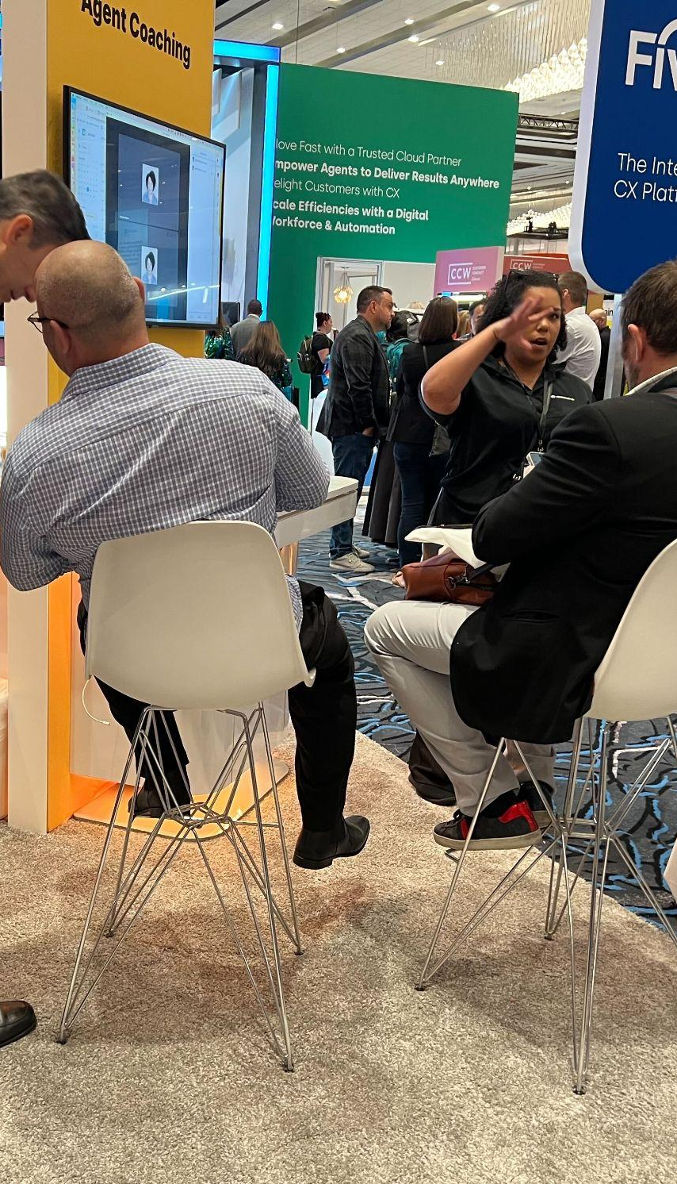
3rd party content syndication
3rd party webinars
Stopping / Paused
3rd Party - High Spend Events
For our particular org we’ve seen limited success with 3rd party content syndication and 3rd party webinars and historically our internal efforts are 3-5X better performing so I am stopping this spend and pulling it all back in house. Also trade show booths costs - although a phenomenal brand asset the spend have to be paused/curbed in order to maintain finance CAC requirements in this market.
Trade show booths (cutting half/reuse vs new )
Only core Sales to Events vs everyone (SQL goal)
Notes:
Revenue target alignment + key metrics like ACV, Funnel Conversion, Marketing Contribution to Pipe
Make sure Finance doesn’t dictate budget prematurely
Joint collaboration: Finance, Sales, Marketing
Finance tells you what budget should be w/o bottom up plan
All parties need to operate as one and off the same numbers– can’t have separate convos between rev ops, finance, marketing etc.

Slide 16
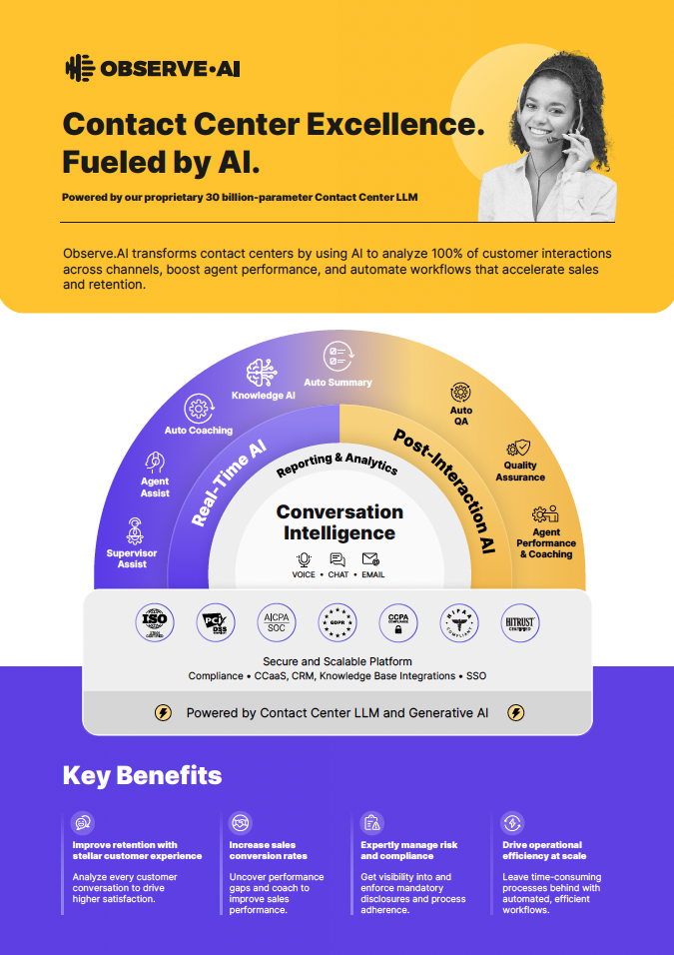
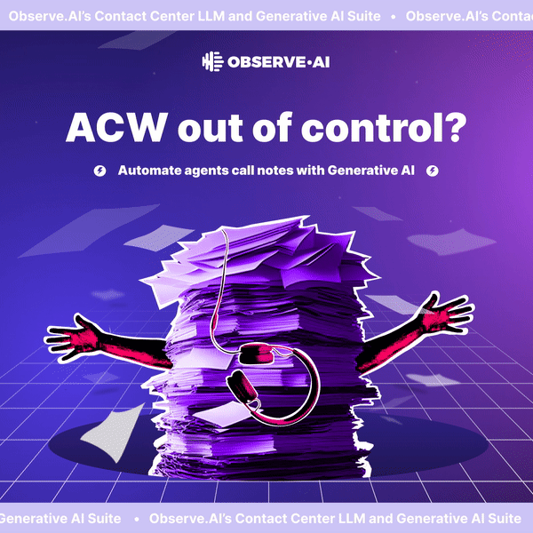
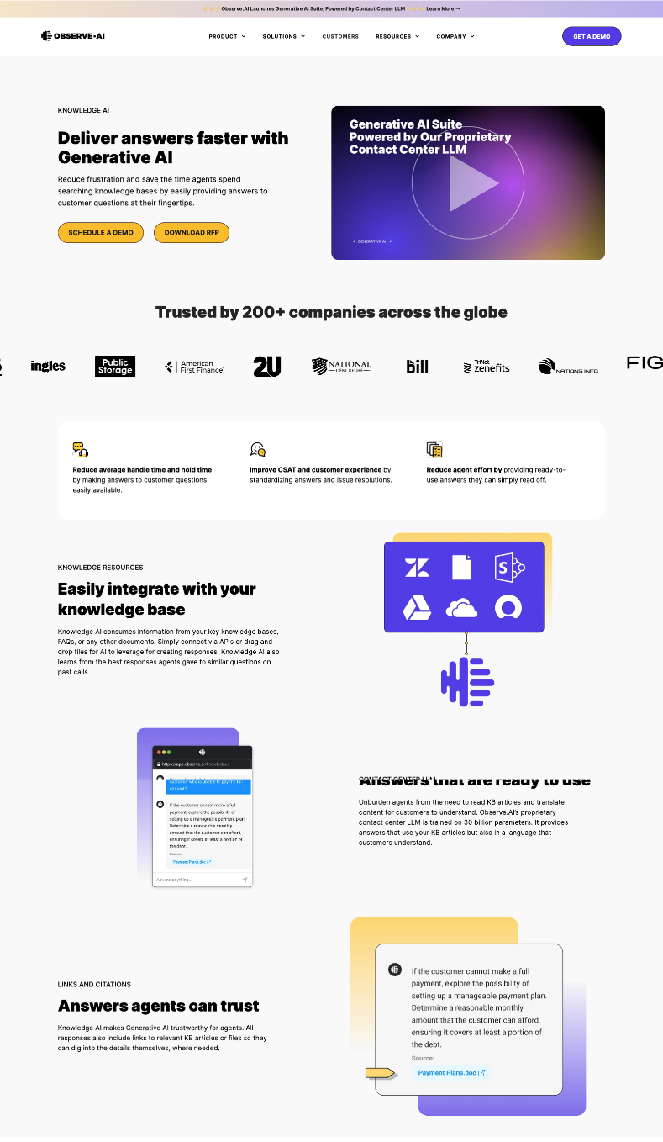

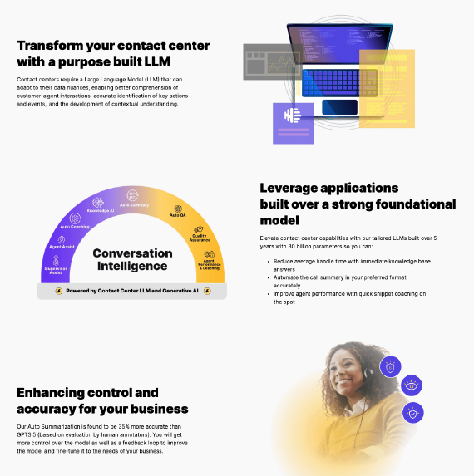
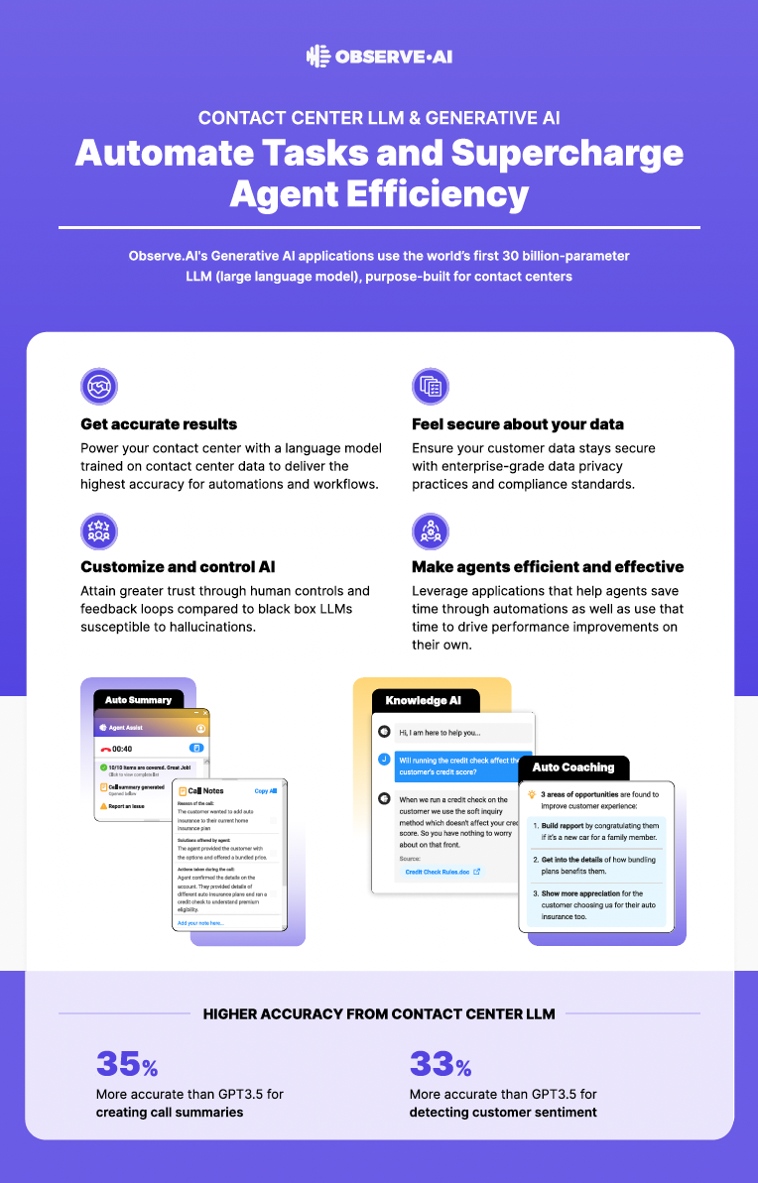
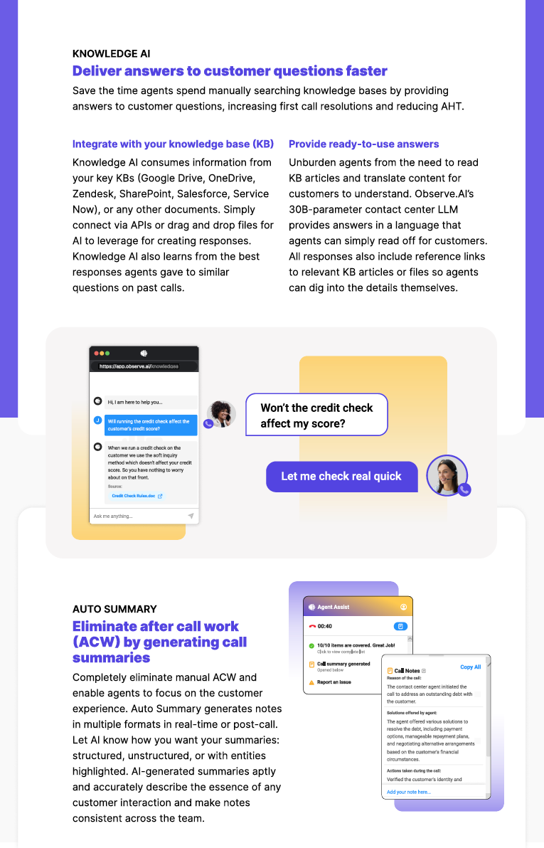
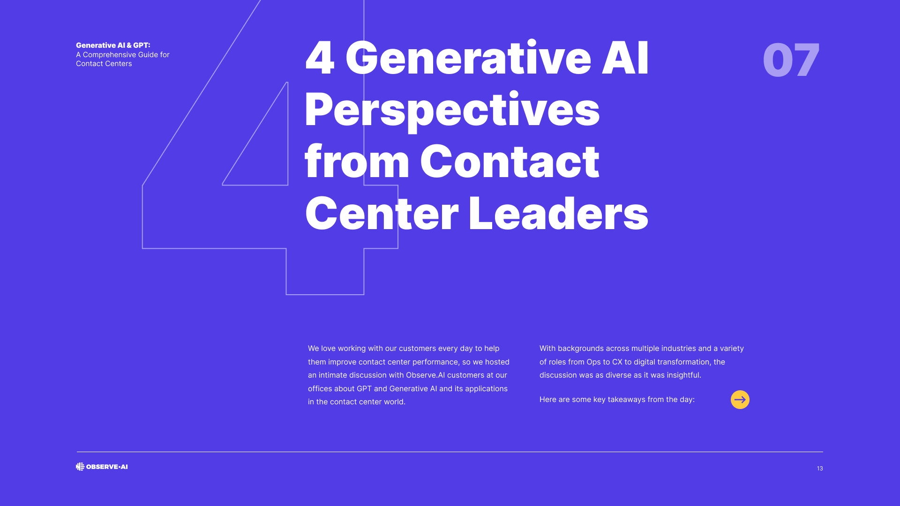
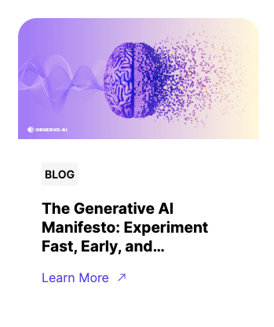
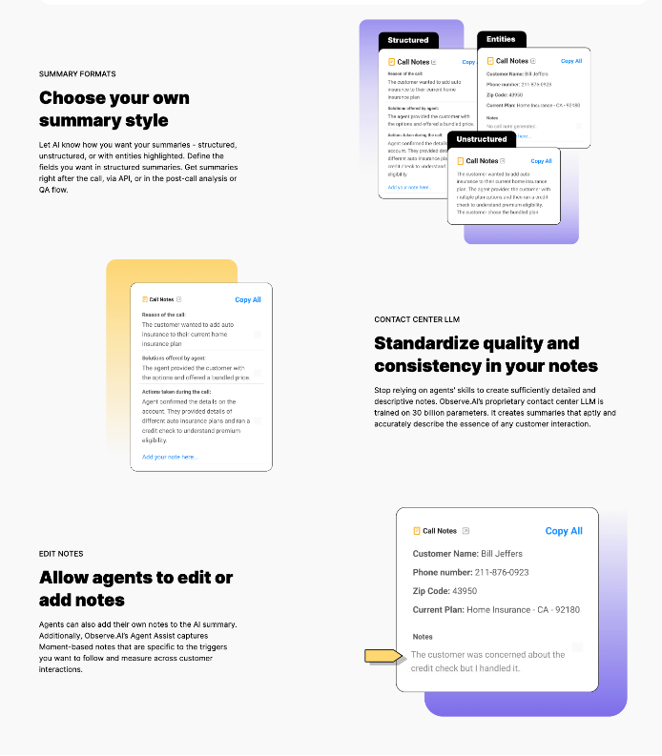
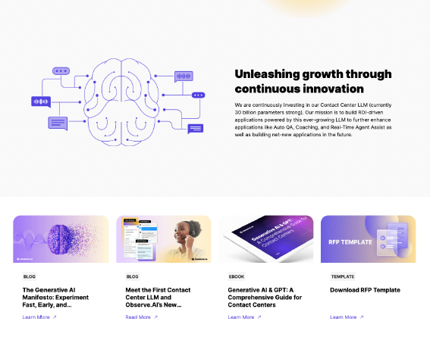
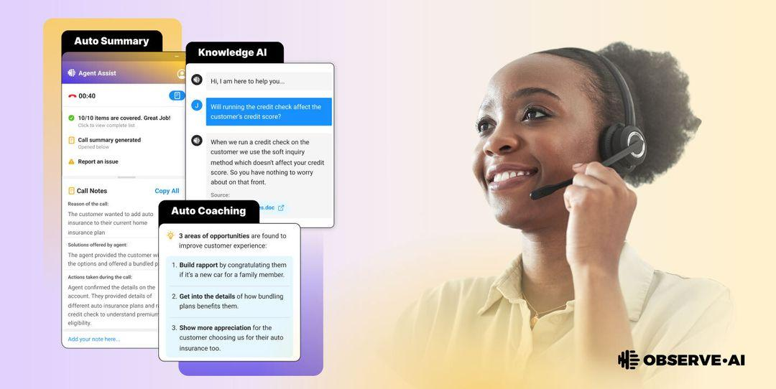
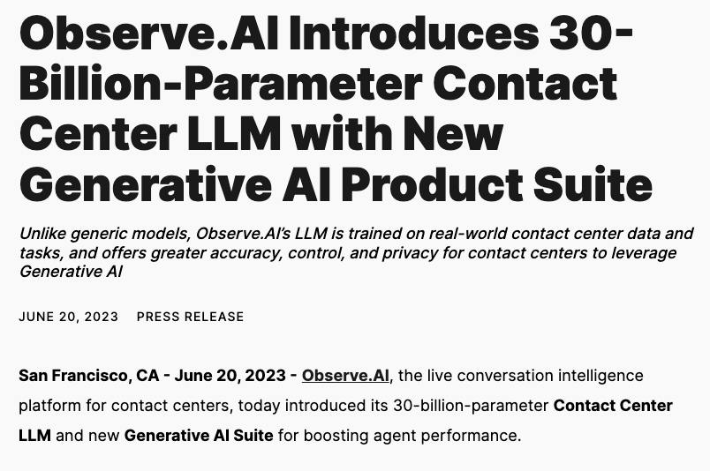
Continue New Content + Paid Social + Ads + Web
Creating Demand Campaigns that fuel organic channels + videos + ads
Capturing Demand Assets that drive conversions + website, new content
Sales Enablement New assets that power our sales team + prove ROI + help close deals

Slide 17

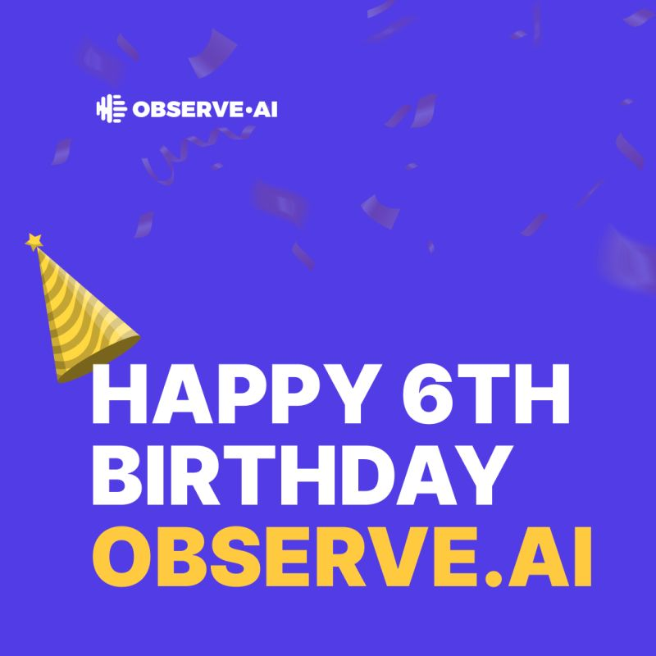
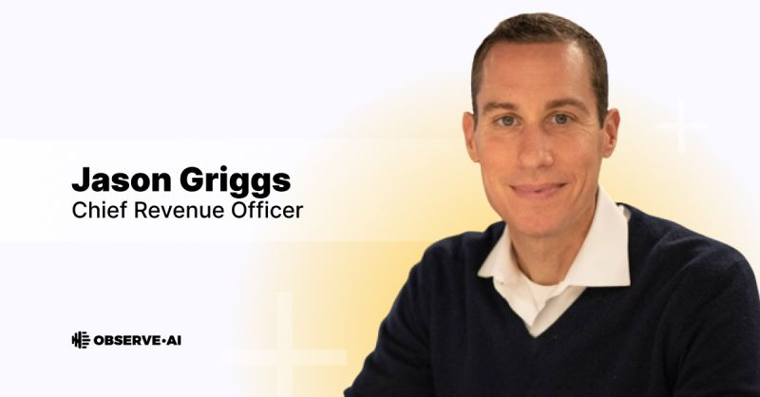
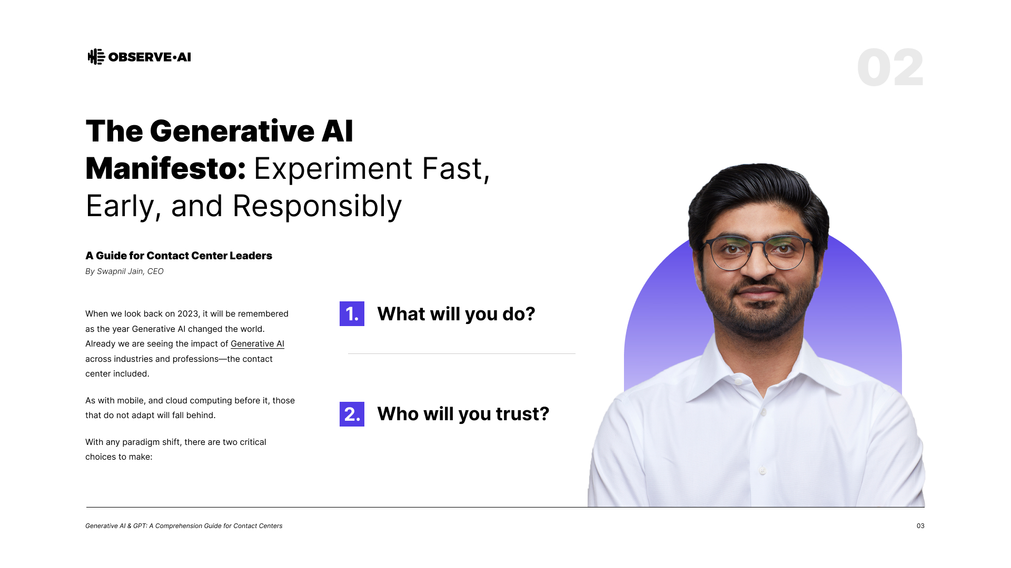
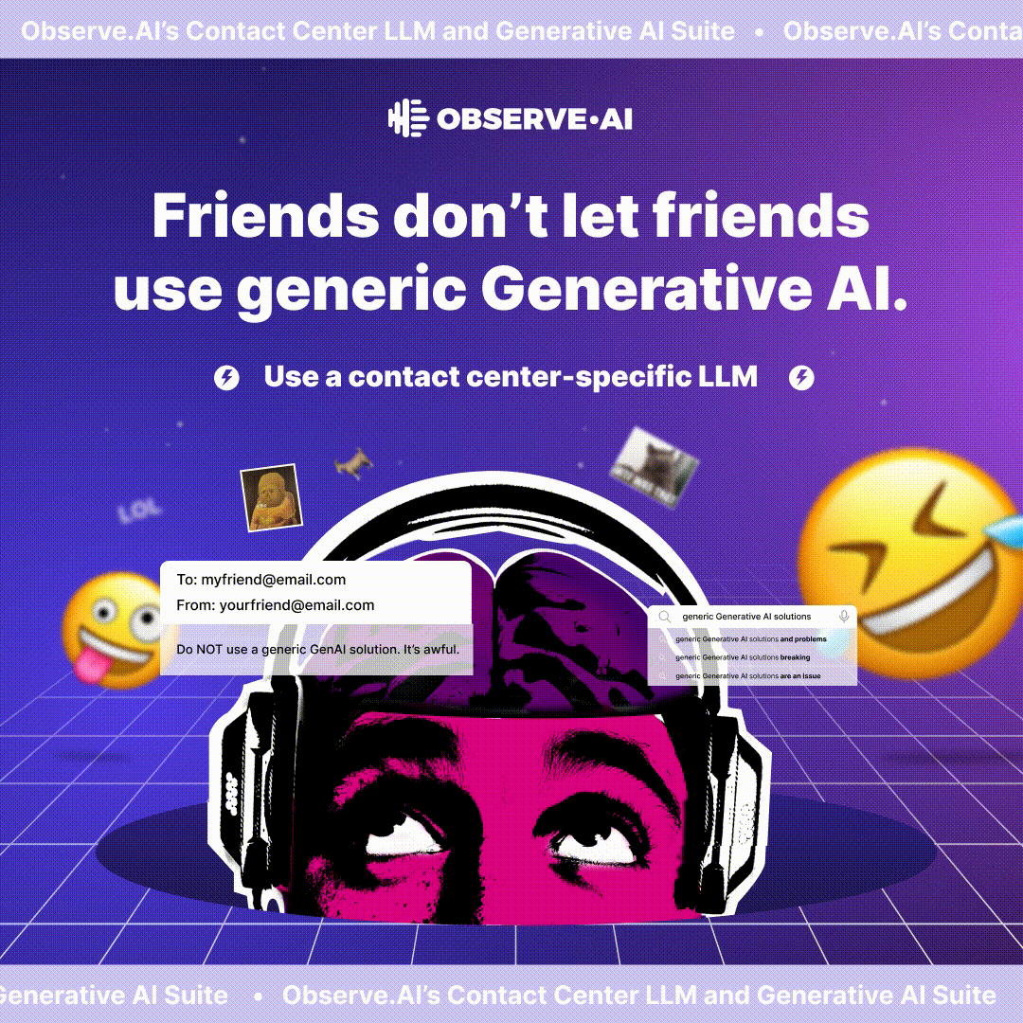
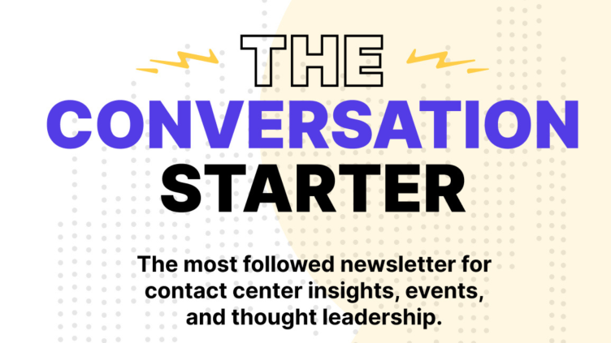
Start / Launch
Thought Leadership + Customers
Thought Leadership + ELT Both LinkedIn + Organic channels
Short Form Video + Customer Advocacy Customers Micro Stories
Brand Campaigns Categories come and go Brand is forever

Slide 18
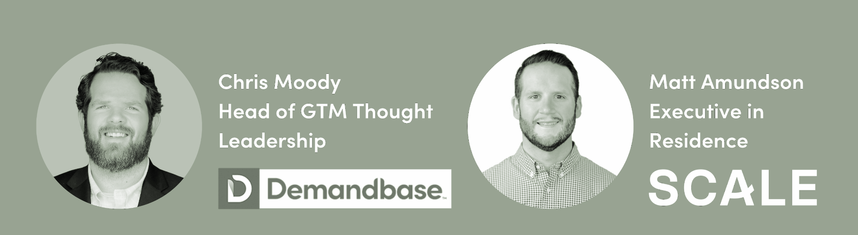
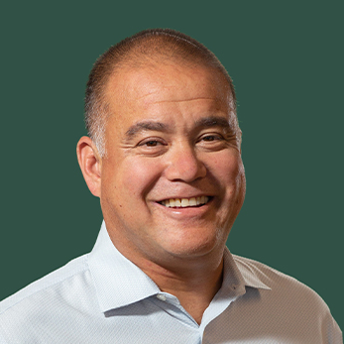
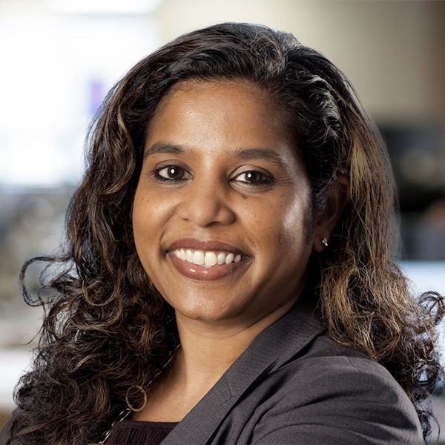
Thank You!
Craig Rosenberg
craig@scalevp.com
Mini Peiris
mini@scalevp.com

