Slide 1
RevOps Council
Building your 2024 tech stack
July 26, 2024

Slide 2



Today’s Revenue Operations Council Session Leaders
Michael Hargis
SVP of Revenue Operations
Ontra AI
Dan Gottlieb
B2B RevTech Analyst
Gartner
Robert Koehler
Sr. GTM Advisor
Scale Venture Partners

Slide 3
Today’s Agenda
Welcome and Introductions (30 min)
Presentation - Optimizing your 2024 tech stack (25 min)
Dan Gottlieb “Sales Tech Mayhem (20) min)
Open Discussion (15 min)

Slide 4
We help our portfolio build and optimize hyper-growth GTM machines

Slide 5
Advisory
Content
Events
Been-to-Market Expertise
Step-by-Step Guides, Workshops
The Power of Community
Advising our portfolio companies with bespoke GTM consulting
Distilling decades of experience into concise GTM content and workshops
Connecting our network of EIRs, Exec Advisors and portfolio execs

Slide 6
Introductions
Name
Title
Company
What sales tech are you the most excited about?

Slide 7
Survey

Slide 8
Overview - A Practical Example that You Can Leverage
Who Can Use This
Companies looking to build out their technology stack to support their Go-To-Market (GTM) teams
Companies with an existing set of tools who are looking to optimize their processes or spend
Approach
This example provides you with a framework to optimize your customer-facing tech stack by applying a process-first approach to identify and resolve key challenges related to system redundancy, capability gaps, and user experience.
Results
In this company, we evaluated a $3m tech stack investment and over 18 months, we reduced spend by more than 25% and improved the end-user experience for our sales, CS and business development functions

Slide 9







































This Company Had a Tech Stack Costing over $3m Annually
Pre-Sales
Qualification
Discovery
Disc. Of Value
Design
Negotiations
Confirmation
Onboarding
Top of Funnel
Middle of Funnel
Late Funnel +
Japan
Core Employee Toolkit
Management Tools
Other Tools
Notes:
Core employee toolkit – Salesforce, Workramp, Okta, Workday, Lattice, Expensify, Highspot, Zoom Conferencing, G-Suite
Management tools – Clari, Tableau, Alteryx, Topo
Other – eliminate Spekit
Middle Funnel – delete Saleshood and
Top of Funnel – add Marketo
Take out percentages

Slide 10
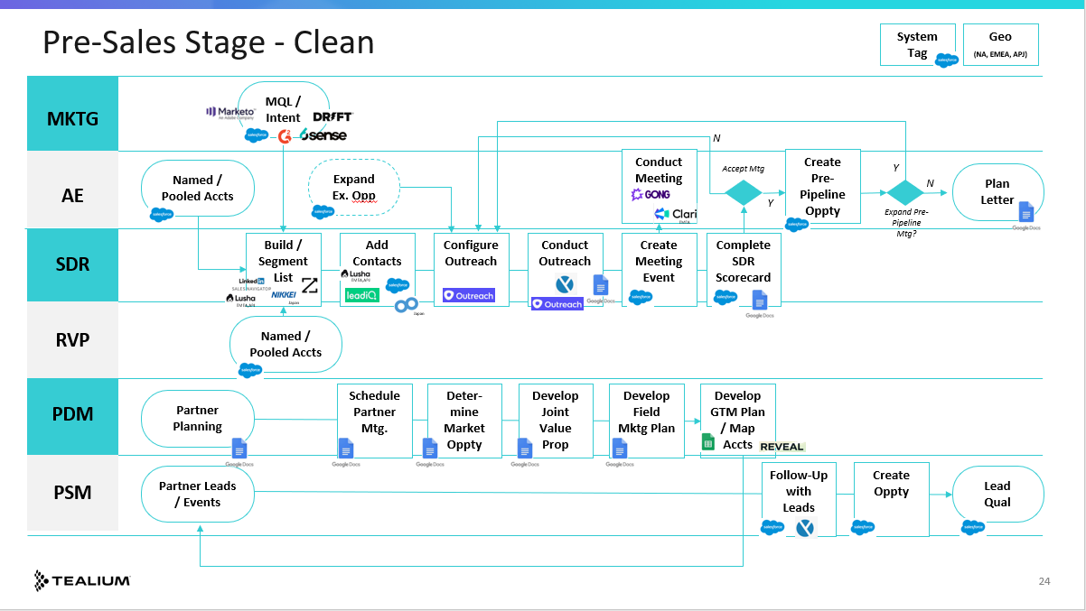
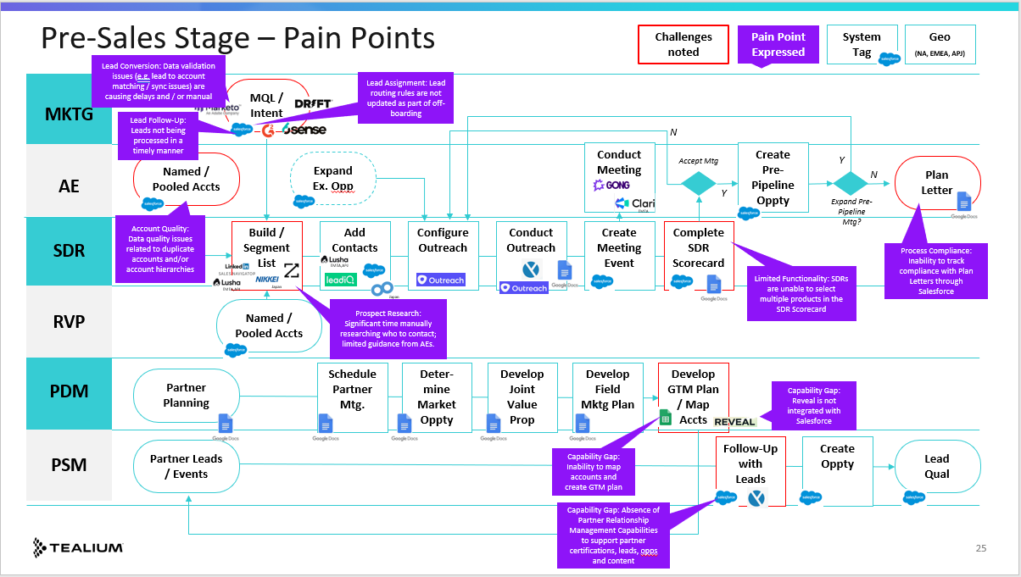
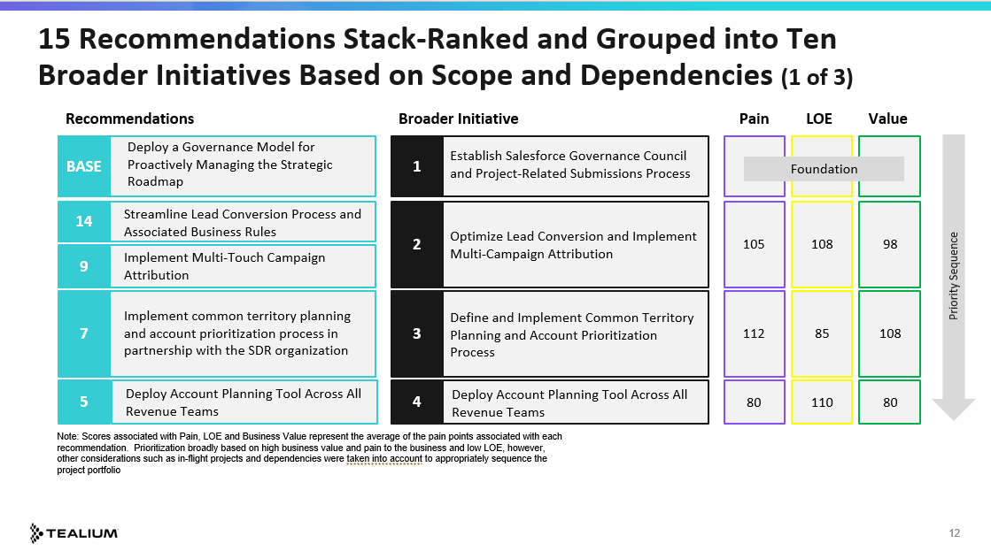
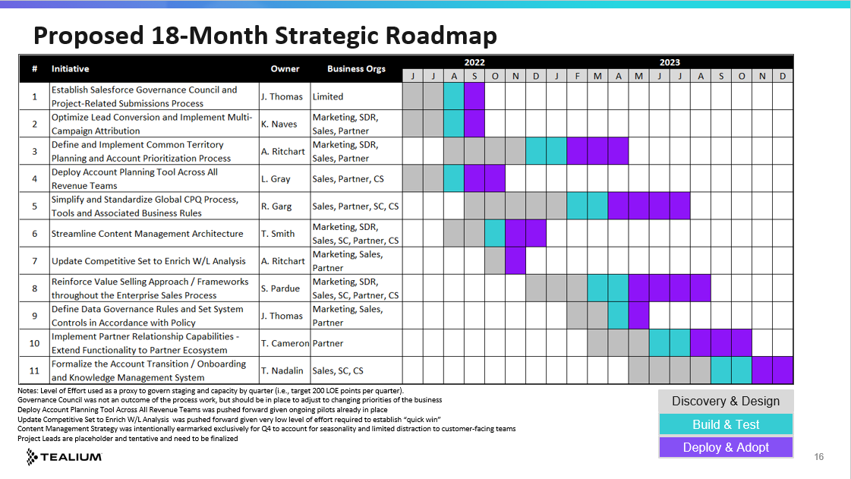
We Took a Phased Approach to the Project
In-Scope Processes
Deliverables
Marketing
SDR
Partners
Sales
Pre-Sales
Qualification
Discovery
1
Document stakeholders and activities across the enterprise sales process
2
Capture key pain points expressed by our customer-facing revenue teams
Disc of Value
Design
Negotiations
Confirmation
Onboarding
3
Prioritize pain points based on degree of pain, LOE to address and business value
4
Develop strategic roadmap based on priorities and tech rationalization opportunities

Slide 11
Define revenue process, identify gaps, create roadmap
Document stakeholders and activities across the enterprise sales process
2
Capture key pain points expressed by our customer-facing revenue teams
1
4
Develop strategic roadmap based on priorities and tech rationalization opportunities
3
Prioritize pain points based on degree of pain, LOE to address and business value

Slide 12
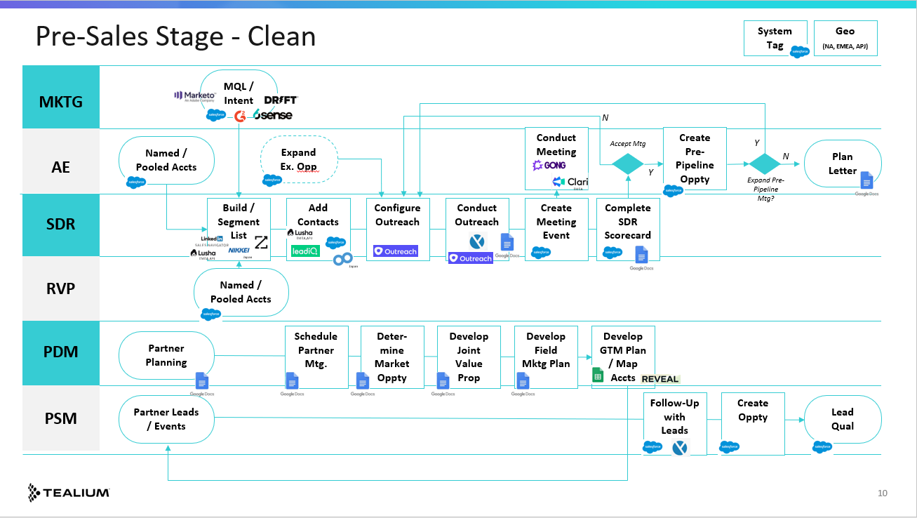
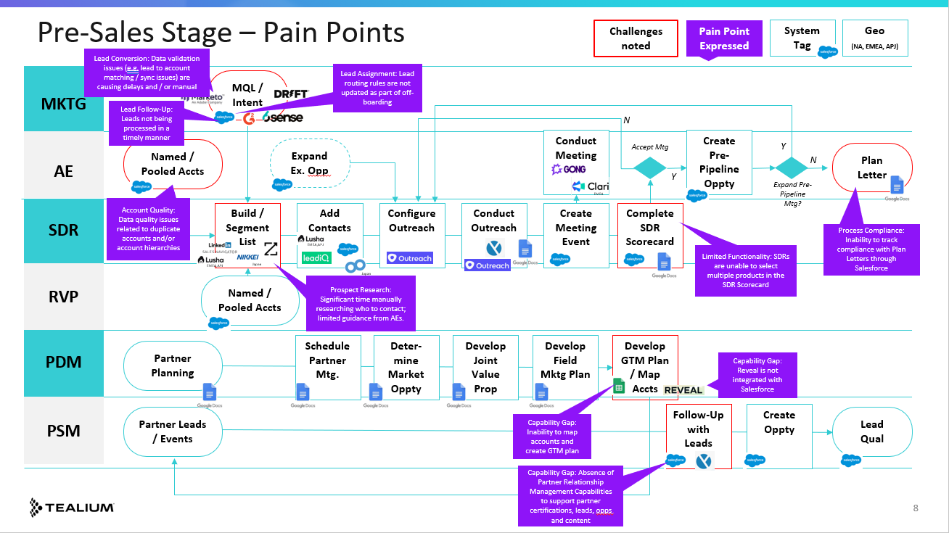
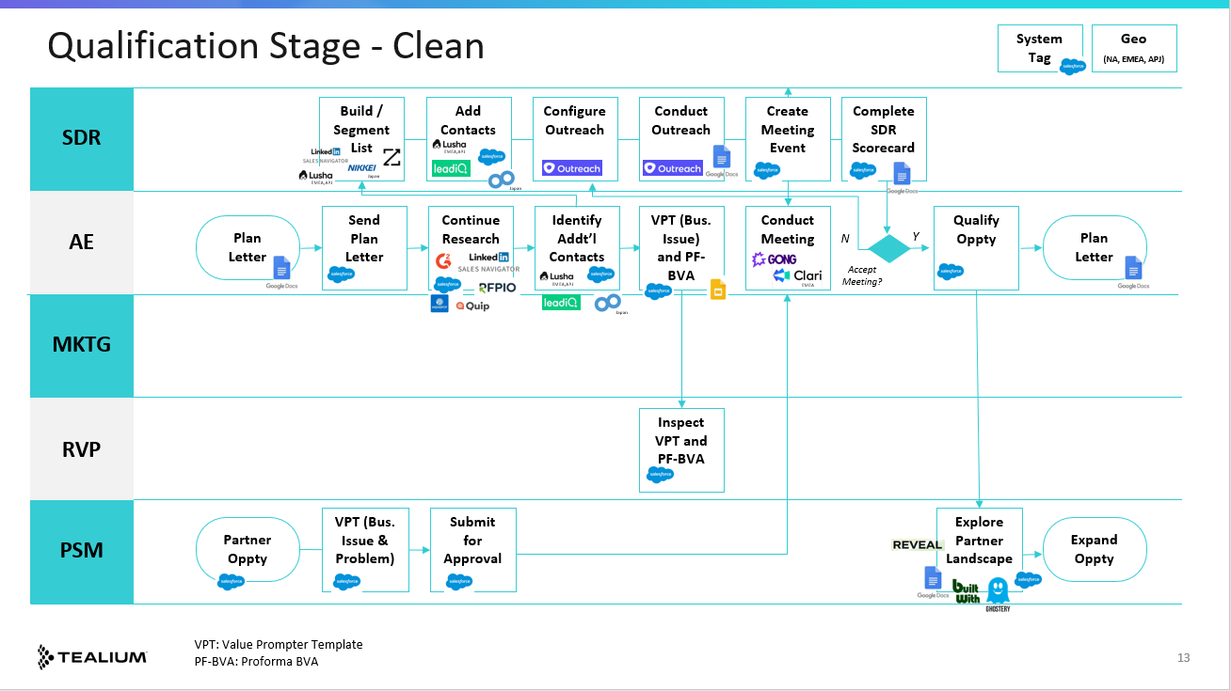
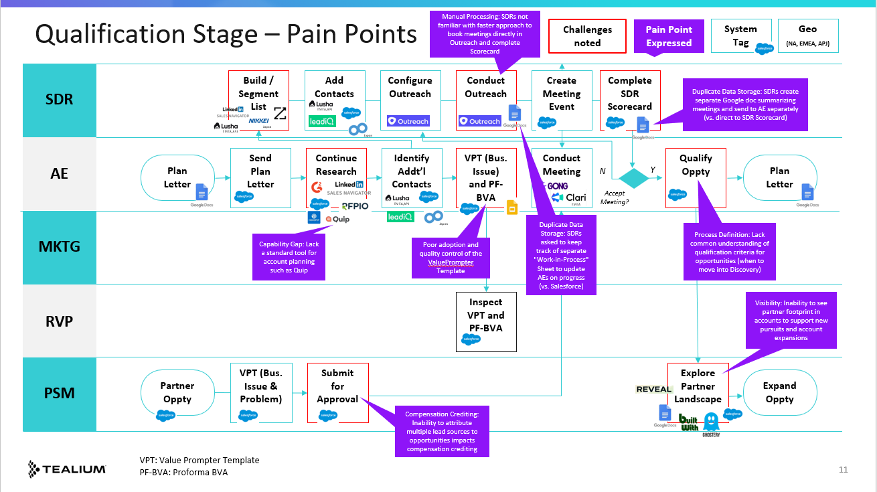
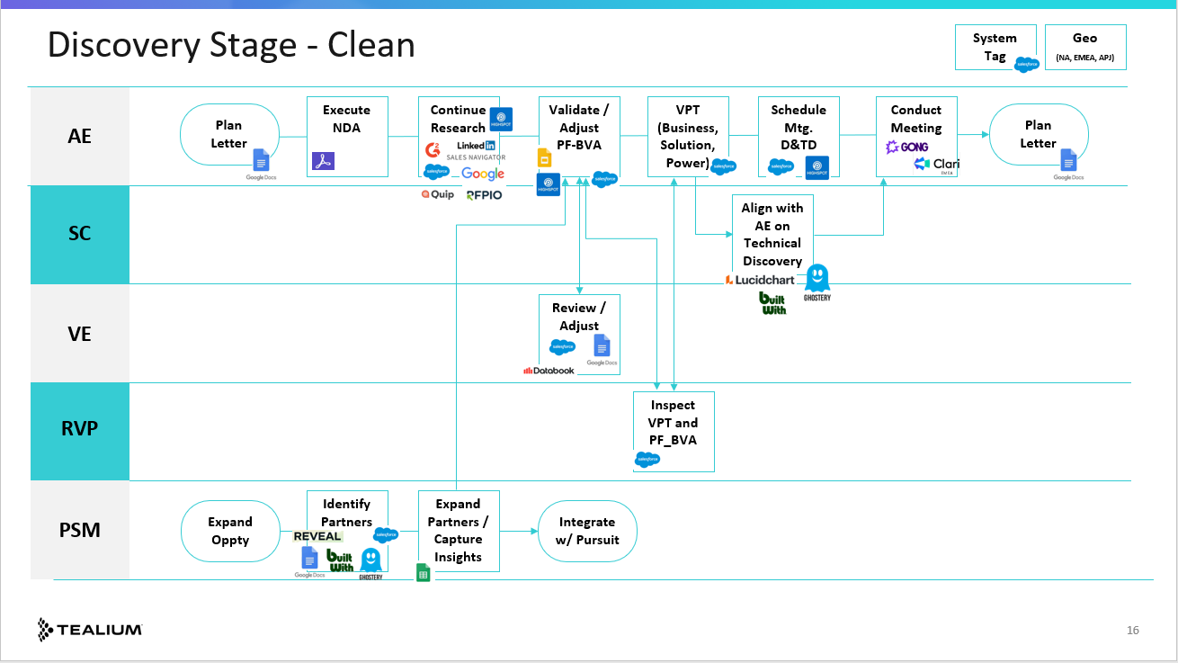
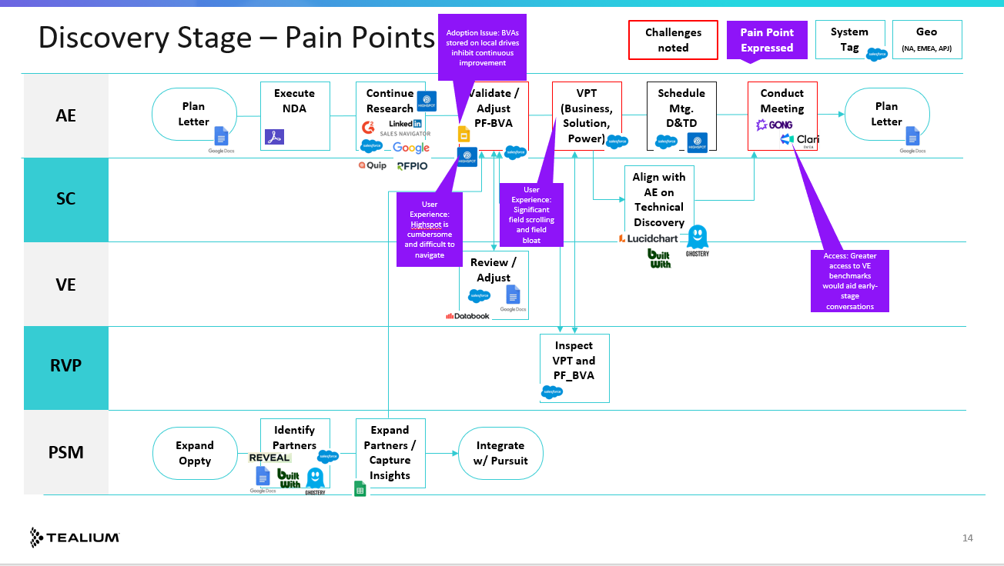
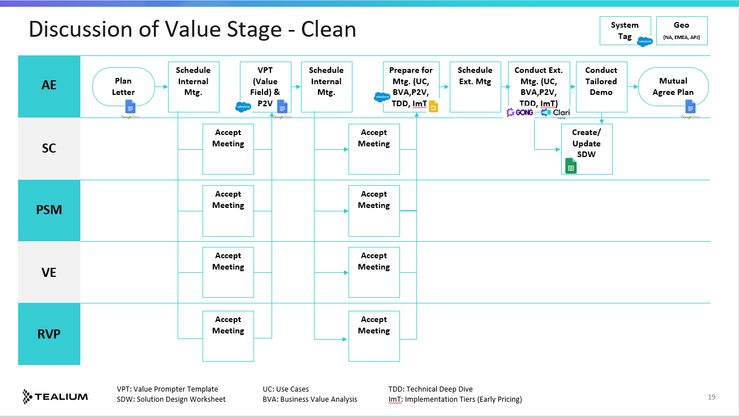
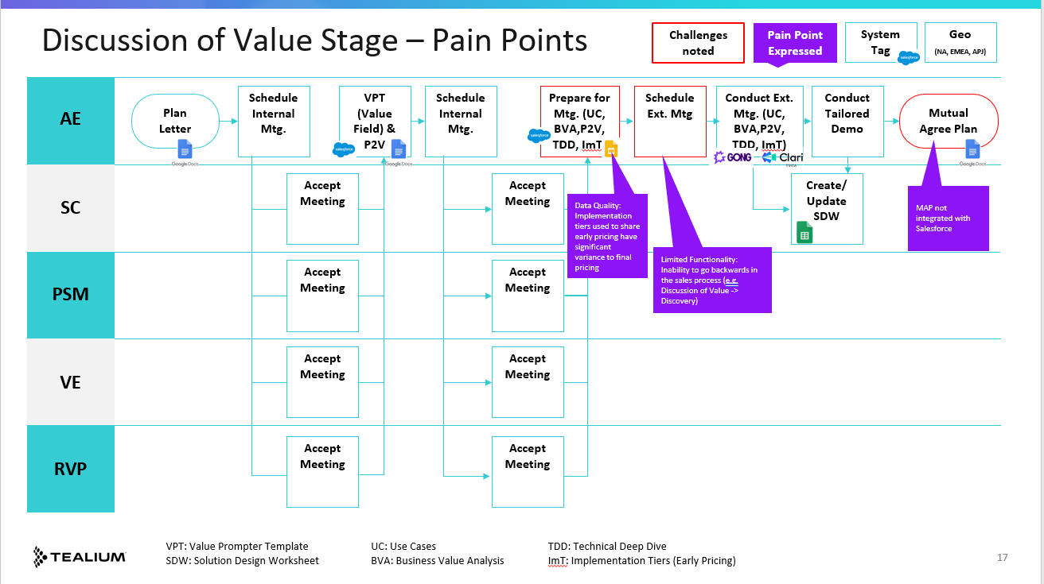
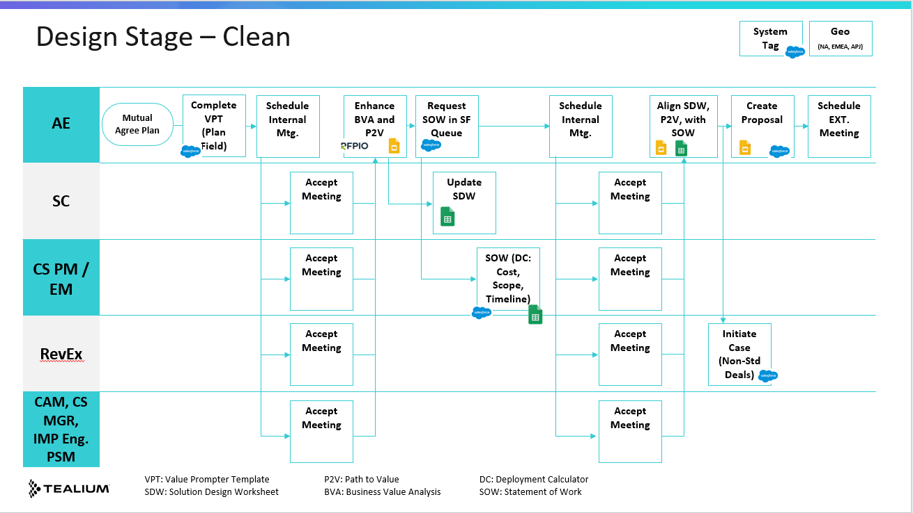
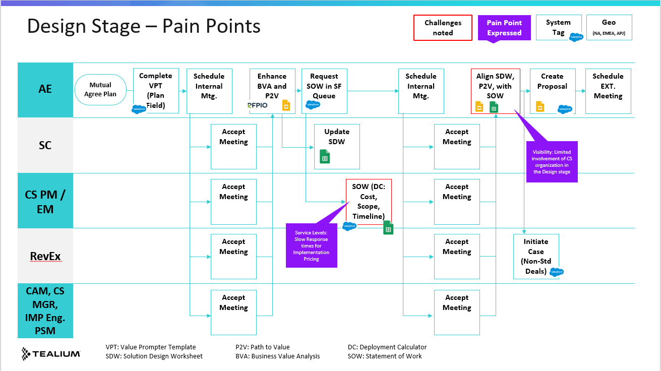
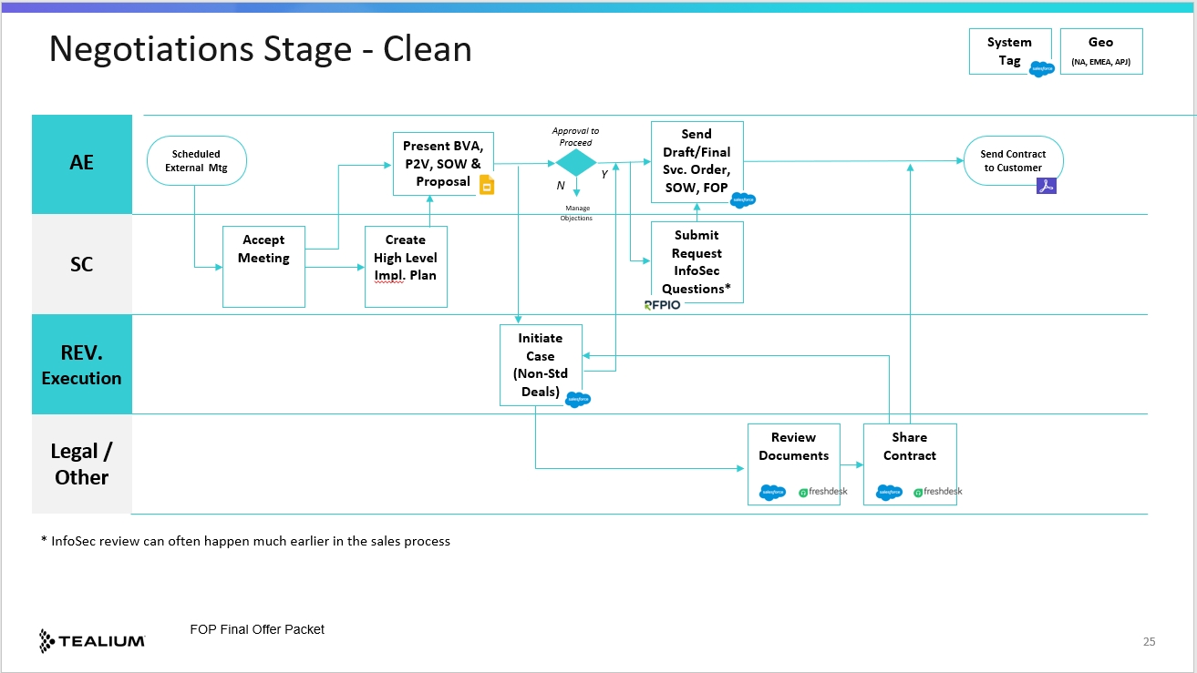
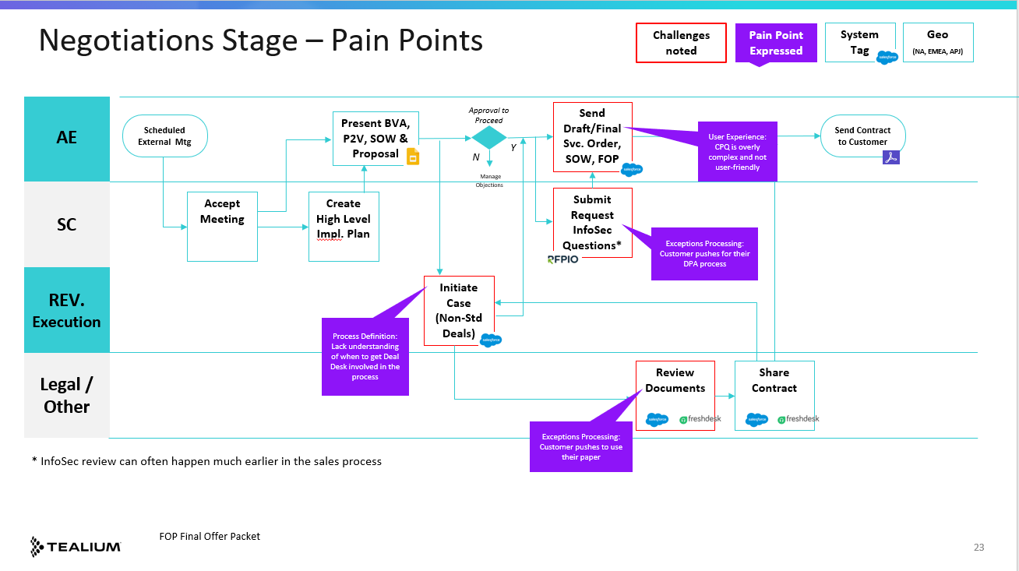
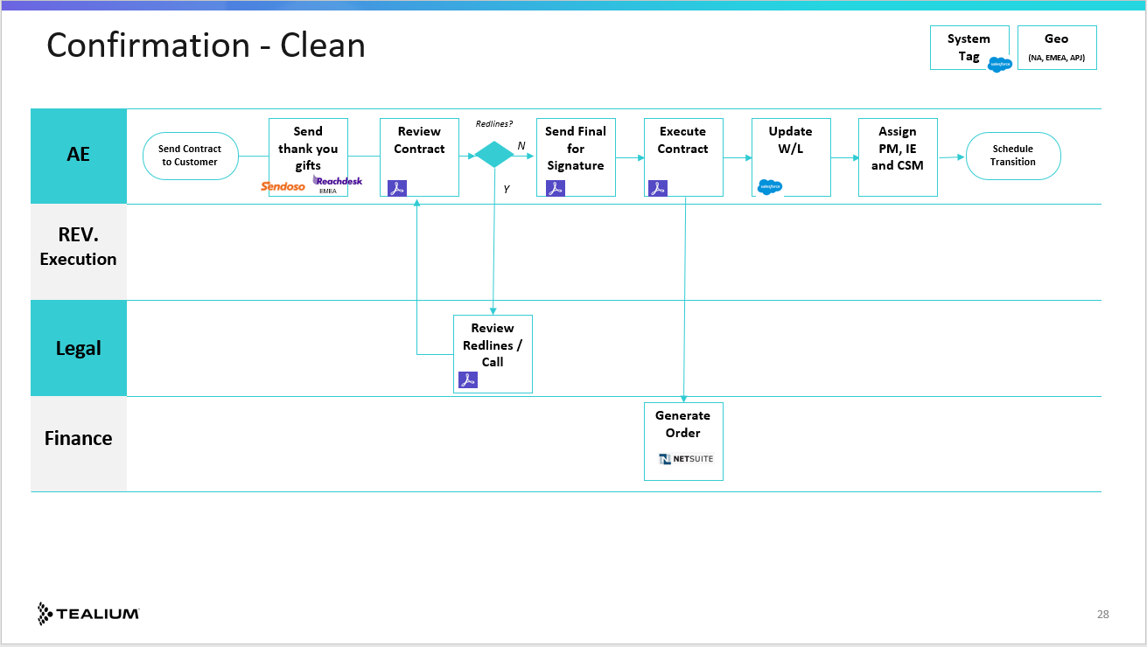
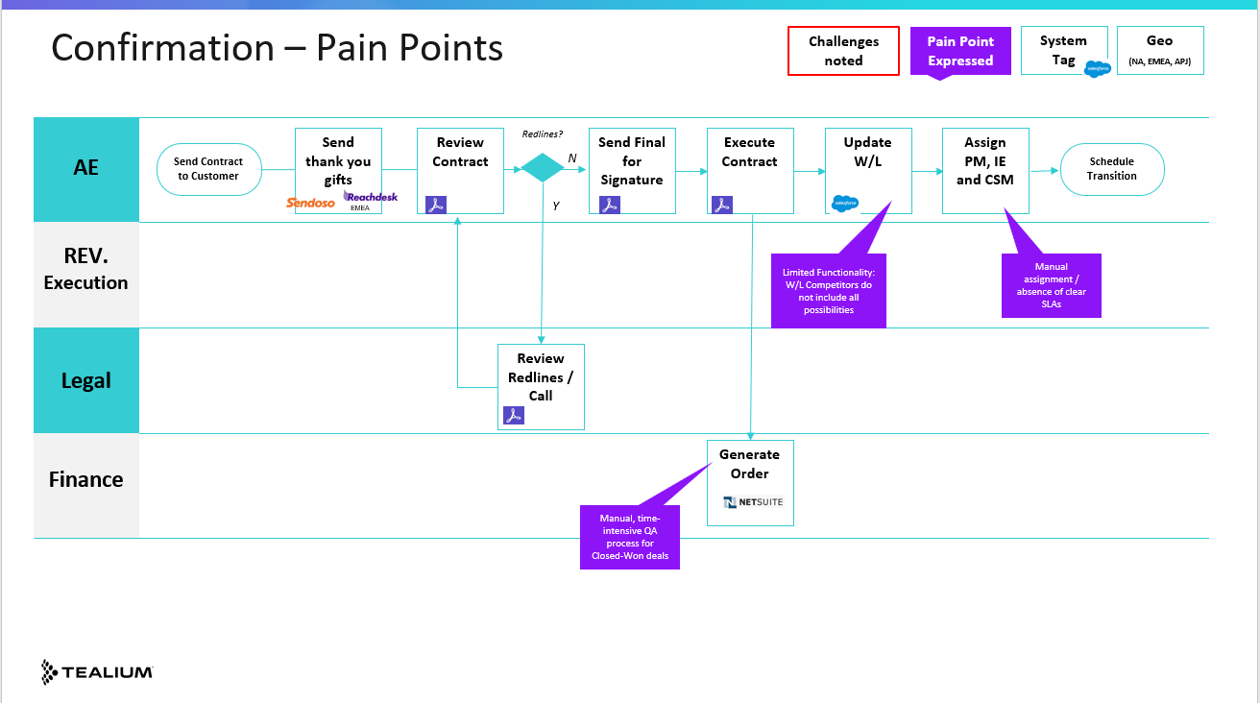
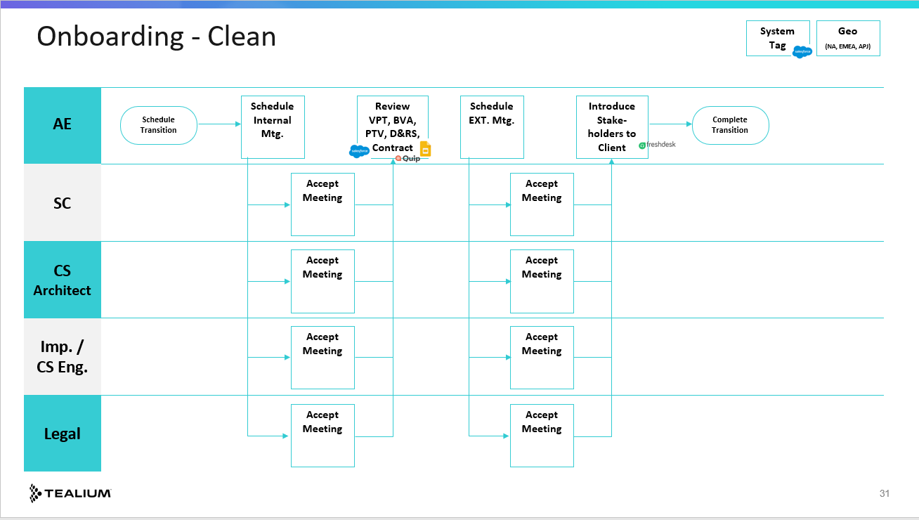
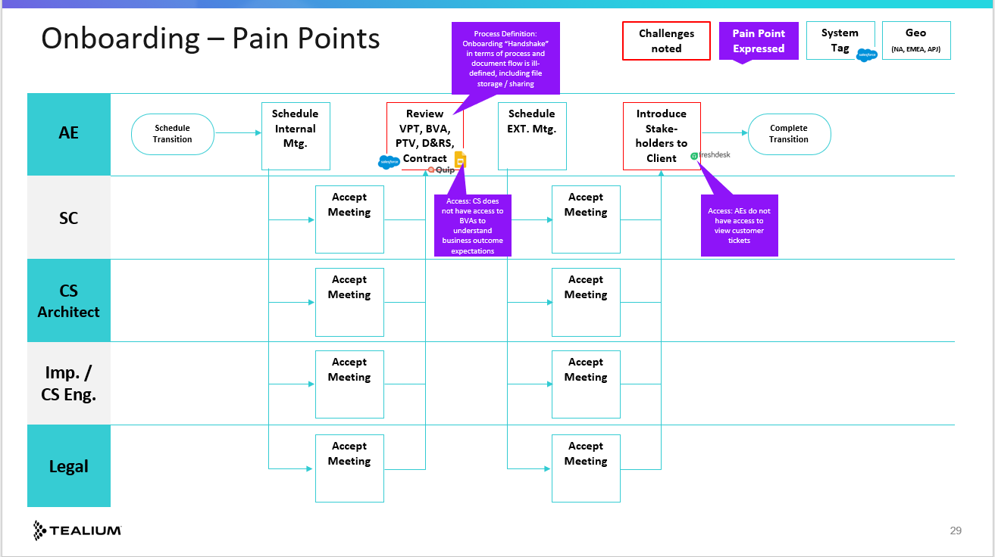
Process Maps were Developed across the Lead to Close Process
Stakeholders, Activities, and Systems/Tools Used
+
Pain Points Expressed by the Business
Process maps developed by broad input / representation from revenue teams
39 pain points expressed throughout lead to close process
Conducted workshop with cross-functional team to finalize process maps and prioritize pain points

Slide 13












Example: Discovery Stage - Clean
System Tag
Geo
(NA, EMEA, APJ)
Plan Letter
Execute NDA
Continue Research
Validate / Adjust
PF-BVA
VPT (Business, Solution, Power)
Schedule Mtg. D&TD
Conduct Meeting
Plan Letter
AE
EMEA
Align with AE on Technical Discovery
SC
VE
Review / Adjust
Inspect VPT and PF_BVA
RVP
PSM
Identify
Partners
Expand Partners / Capture Insights
Expand Oppty
Integrate w/ Pursuit

Slide 14
Example: Discovery Stage – Pain Points
Adoption Issue: BVAs stored on local drives inhibit continuous improvement
Challenges noted
Pain Point Expressed
System Tag
Geo
(NA, EMEA, APJ)
Plan Letter
Execute NDA
Continue Research
Validate / Adjust
PF-BVA
VPT (Business, Solution, Power)
Schedule Mtg. D&TD
Conduct Meeting
Plan Letter
AE
EMEA
Align with AE on Technical Discovery
SC
User Experience: Highspot is cumbersome and difficult to navigate
User Experience: Significant field scrolling and field bloat
VE
Review / Adjust
Access: Greater access to VE benchmarks would aid early-stage conversations
Inspect VPT and PF_BVA
RVP
PSM
Identify
Partners
Expand Partners / Capture Insights
Expand Oppty
Integrate w/ Pursuit

Slide 15
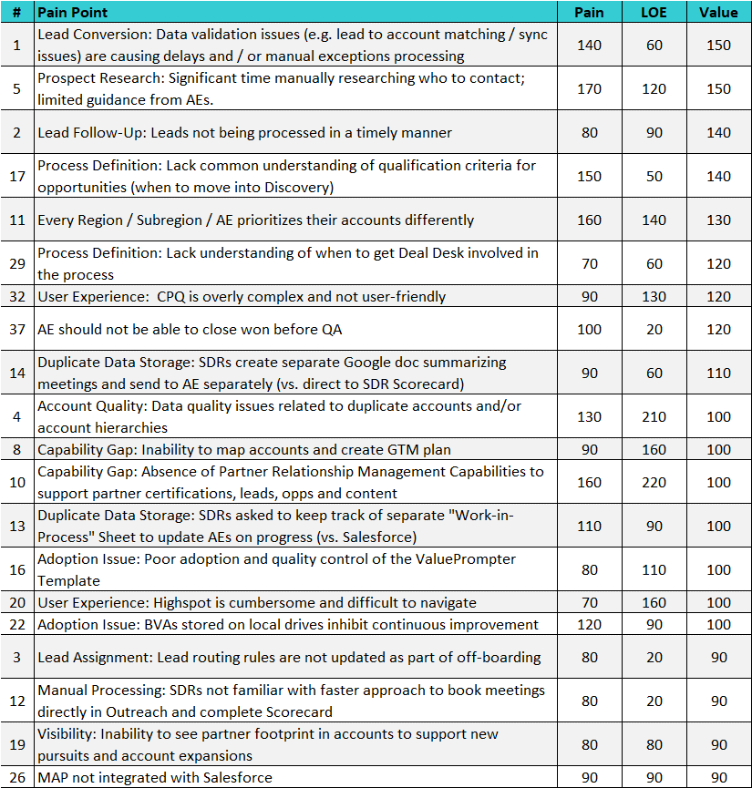
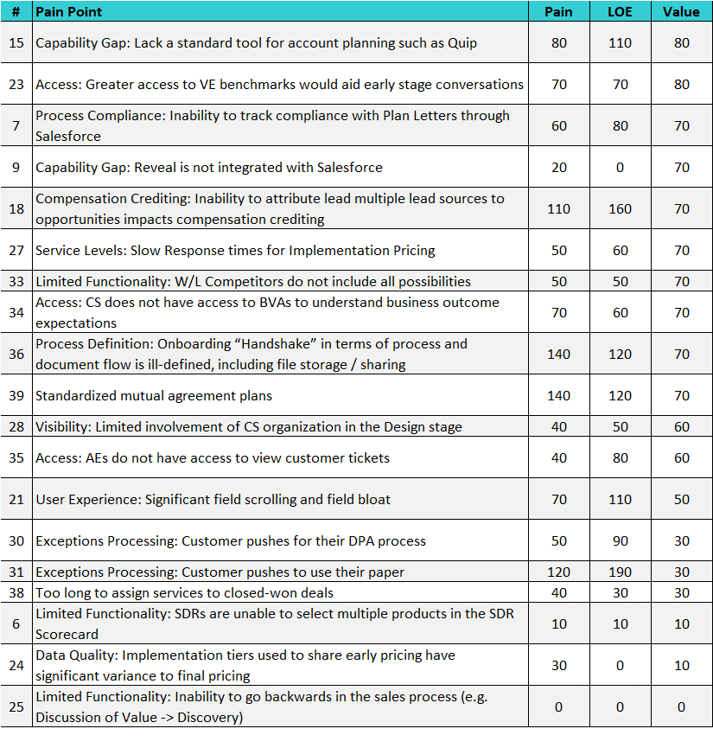
We Scored Each of the Pain Points on Three Variables
Workshop participants prioritized pain points based on 3 criteria
Pain to the Business
Level of Effort (LOE) to Address
Business Value
Scores were normalized to analyze relative weightings
Pain points were stack-ranked based on potential to add business value
Note: “#” corresponds to where the pain point is expressed in the lead to close process (e.g., Pain Points associated with Pre-sales stage include #’s 1 – 10. Six pain points deprioritized given low relative scores.

Slide 16
We Interviewed End Users and Summarized the Key Themes and Opportunities
“We don’t have standard qual. criteria; it’s discretionary as long as it roughly follows BANT principles” – RVP, Americas
“I’m not sure what the standards are for a Mutual Agreement Plan; I’ve seen them done many different ways” - Account Executive
“Negotiations is the most challenging; I’m never clear on when we bring in RevOps and Legal” - Account Executive
1
Opportunities to tighten up sales process definitions and execution practices
2
Opportunities to redefine, reset and reimplement value selling frameworks
“We have opportunities sitting six months in Discovery and we can’t seem to get to value” – Senior AE
“An AE will sometimes request a demo at the Discussion of Value stage because they don’t know how to sell value” - SC
“We need a reset on our approach to value selling as we are struggling with adoption. There’s such a big rush to demo” - VE
3
Opportunities to better define data and content architecture and governance
“Better data hygiene is needed. Anyone can create an account, many dupes and poorly constructed hierarchies” – Mktg Ops
“I’d estimate only 10-15% of our AEs know how to navigate and use Highspot effectively” – RVP, Americas
“We don’t currently have a process in place to proactively prioritize projects which move the needle for the business” – Salesforce Admin
4
Opportunities to streamline solution design and development process
“CPQ is unwieldy, so we don’t even use it – we farm that out to RevOps because it’s way too complicated” – RVP EMEA
“We need to migrate from being a stop-gap measure and develop a more defined CPQ process and workflow” – Revenue Execution
“Would like to get to a point where 80% of deals are ‘no-touch.’ We’re not anywhere near that now” – Revenue Execution
5
Opportunities to invest in further education and enablement of systems and process
“I’m not sure any of us know how to book meetings directly in Outreach…that’s a huge time-saver” – SDR
“I don’t know when to push a deal from Discovery into Discussion of Value…it seems very undefined” – Account Executive
“We need help identifying who we should be contacting…even including ‘personas’ on the contact record would be helpful” – SDR

Slide 17
We Developed Recommendations to Address Pain Points (1 of 4)
Expressed Pain Points
Recommendations
Inability to access to VE benchmarks would aid early-stage conversations
1
Define Common Approach to Archiving and Accessing VE Tools and Benchmarks
Data quality issues related to duplicate accounts and/or account hierarchies
2
Define Data Governance Rules (e.g., Account Creation, ICP Assignments) and Set System Controls in Accordance with Policy
Highspot is cumbersome and difficult to navigate
3
Streamline Content Management Architecture
Inability to see partner footprint in accounts to support new pursuits and account expansions
4
Enhance Account Object to Capture Partner Relationships within Existing and ICP Accounts
Lack a standard, fully deployed tool for account planning
5
Deploy Account Planning Tool Across All Revenue Teams
Limited CS access to BVAs
6
Onboarding “Handshake” in terms of process and document flow is ill-defined, including file storage / sharing
Formalize the Account Transition and Onboarding Process and Knowledge Management System
Limited involvement of CS organization in the Design stage
Long cycle times to assign services to closed-won deals

Slide 18
Recommendations to Address Pain Points (2 of 4)
Expressed Pain Points
Recommendations
Significant time manually researching who to contact; limited guidance
7
Every Region / Subregion / AE prioritizes their accounts differently
Implement common territory planning and account prioritization process in partnership with the SDR organization
SDRs create separate Google doc summarizing meetings
SDRs asked to keep track of separate "Work-in-Process" Sheet
SDRs not familiar with faster approach to book meetings in Outreach
Inability to track compliance with plan letters through Salesforce
Absence of PRM Capabilities for certifications, leads, opportunities and content
8
Implement Full Lifecycle Partner Relationship Management Capabilities
Inability to attribute lead multiple lead sources to opportunities impacts compensation crediting
9
Implement Multi-Touch Campaign Attribution
Inability to map accounts and create GTM plan
10
Integrate Reveal with Salesforce to enhance Account Mapping Capabilities
Associated Pain Points
Recommendation
Reveal is not integrated with Salesforce

Slide 19
Recommendations to Address Pain Points (3 of 4)
Expressed Pain Points
Recommendations
11
Poor adoption and quality control of the ValuePrompter Template
Re-educate Sales Teams on the Expectations of RVPs and AEs related to Value Selling Tools and Assets
No standard expectations for mutual agreement plans
MAP not integrated with Salesforce
Lack common understanding of qualification criteria for opportunities (when to move into Discovery)
12
Revisit Strategy / Approach for Integrating Value Engineering Expertise and Tools in the Sales Process
BVAs stored on local drives inhibit continuous improvement
Lack understanding of when to get Deal Desk involved in the process
13
CPQ is overly complex and not user-friendly
AE should not be able to close won before QA
Simplify and Standardize Global CPQ Process, Tools and Associated Business Rules
Slow Response times for Implementation Pricing
Implementation tiers have significant variance to final pricing

Slide 20
Recommendations to Address Pain Points (4 of 4)
Expressed Pain Points
Recommendations
Data validation issues (e.g. lead to account matching / sync issues) are causing delays and / or manual exceptions processing
14
Streamline Lead Conversion Process and Associated Business Rules
Leads not being processed in a timely manner
Lead routing rules are not updated as part of off-boarding
W/L Competitors do not include all possibilities
15
Update Competitive Set to Enrich W/L Analysis

Slide 21
15 Recommendations Stack-Ranked and Grouped into Ten Broader Initiatives Based on Scope and Dependencies (1 of 3)
Recommendations
Broader Initiative
Pain
LOE
Value
BASE
Deploy a Governance Model for Proactively Managing the Strategic Roadmap
1
Establish Salesforce Governance Council and Project-Related Submissions Process
Foundation
14
Streamline Lead Conversion Process and Associated Business Rules
2
Optimize Lead Conversion and Implement Multi-Campaign Attribution
105
108
98
9
Implement Multi-Touch Campaign Attribution
Priority Sequence
7
Implement common territory planning and account prioritization process in partnership with the SDR organization
3
Define and Implement Common Territory Planning and Account Prioritization Process
112
85
108
5
Deploy Account Planning Tool Across All Revenue Teams
4
Deploy Account Planning Tool Across All Revenue Teams
80
110
80
Note: Scores associated with Pain, LOE and Business Value represent the average of the pain points associated with each recommendation. Prioritization broadly based on high business value and pain to the business and low LOE, however, other considerations such as in-flight projects and dependencies were taken into account to appropriately sequence the project portfolio

Slide 22
15 Recommendations Stack-Ranked and Grouped into Ten Broader Initiatives Based on Scope and Dependencies (2 of 3)
Recommendations
Broader Initiative
Pain
LOE
Value
13
Simplify and Standardize Global CPQ Process, Tools and Associated Business Rules
5
Simplify and Standardize Global CPQ Process, Tools and Associated Business Rules
68
54
88
3
Streamline Content Management Architecture
6
Streamline Content Management Architecture
70
160
100
15
Update Competitive Set to Enrich W/L Analysis
7
Update Competitive Set to Enrich W/L Analysis
50
50
Priority Sequence
70
12
Revisit Strategy / Approach for Integrating Value Engineering Expertise and Tools in the Sales Process
8
11
Re-educate Sales Teams on the Expectations of RVPs and AEs related to Value Selling Tools and Assets
Reinforce Value Selling Approach and Frameworks throughout the Enterprise Sales Process
103
82
96
1
Define Common Approach to Archiving and Accessing VE Tools and Benchmarks
Note: Scores associated with Pain, LOE and Business Value represent the average of the pain points associated with each recommendation. Prioritization broadly based on high business value and pain to the business and low LOE, however, other considerations such as in-flight projects and dependencies were taken into account to appropriately sequence the project portfolio

Slide 23
15 Recommendations Stack-Ranked and Grouped into Ten Broader Initiatives Based on Scope and Dependencies (3 of 3)
Recommendations
Broader Initiative
Pain
LOE
Value
2
Define Data Governance Rules (e.g., Account Creation, ICP Assignments) and Set System Controls in Accordance with Policy
9
Define Data Governance Rules (e.g., Account Creation, ICP Assignments) and Set System Controls in Accordance with Policy
130
210
100
4
Enhance Account Object to Capture Partner Relationships within Existing and ICP Accounts
10
Implement Partner Relationship Capabilities to Extend Functionality to Partner Ecosystem
Priority Sequence
8
Implement Full Lifecycle Partner Relationship Management Capabilities
98
127
92
10
Integrate Reveal with Salesforce to enhance Account Mapping Capabilities
6
Formalize the Account Transition and Onboarding Process and Knowledge Management System
11
Formalize the Account Transition and Onboarding Process and Knowledge Management System
73
65
58
Note: Scores associated with Pain, LOE and Business Value represent the average of the pain points associated with each recommendation. Prioritization broadly based on high business value and pain to the business and low LOE, however, other considerations such as in-flight projects and dependencies were taken into account to appropriately sequence the project portfolio

Slide 24
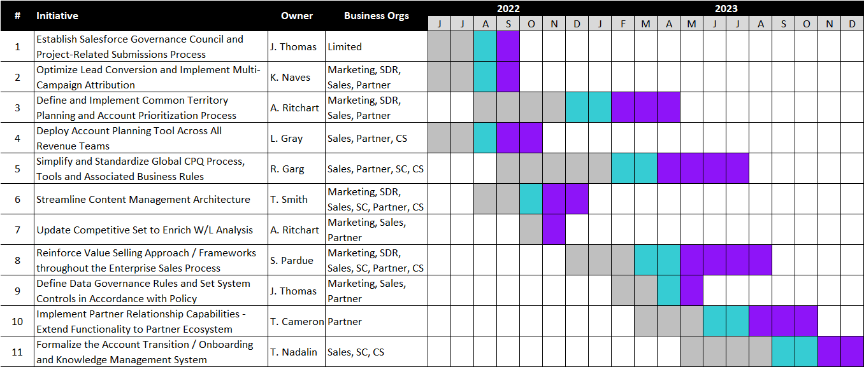
And Finally We Developed an 18-month Execution Roadmap
Potential bottlenecks
Notes: Level of Effort used as a proxy to govern staging and capacity by quarter (i.e., target 200 LOE points per quarter).
Governance Council was not an outcome of the process work, but should be in place to adjust to changing priorities of the business
Deploy Account Planning Tool Across All Revenue Teams was pushed forward given ongoing pilots already in place
Update Competitive Set to Enrich W/L Analysis was pushed forward given very low level of effort required to establish “quick win”
Content Management Strategy was intentionally earmarked exclusively for Q4 to account for seasonality and limited distraction to customer-facing teams
Project Leads are placeholder and tentative and need to be finalized
Discovery & Design
Build & Test
Deploy & Adopt

Slide 25
Results
Established Tech Stack Governance Council and aligned on a regular cadence
Leveraged the detailed process maps for a number of different use cases after the project was done - training, process deep dives, onboarding
Ultimately reduce our tech stack op ex by 25% while improving end user experience

Slide 26
Sales Tech Mayhem

Slide 27
Dan’s 7 Sales Tech Updates
Let’s Ask The Reps: How do you use AI?
AI Partnership = New Seller Competency
WTF is Generative Value Messaging?
Sales Tech Mayhem: Market Convergence
Hello, “Action Platforms”
Spotting Differentiators
AI Changing The UX of Sales Tech

Slide 28
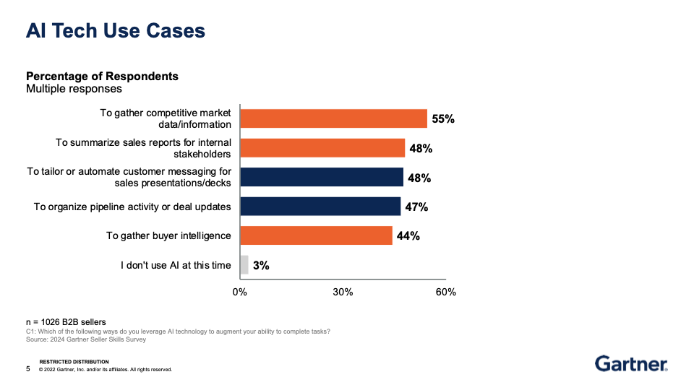
Let’s ask the reps: how do you use AI?

Slide 29
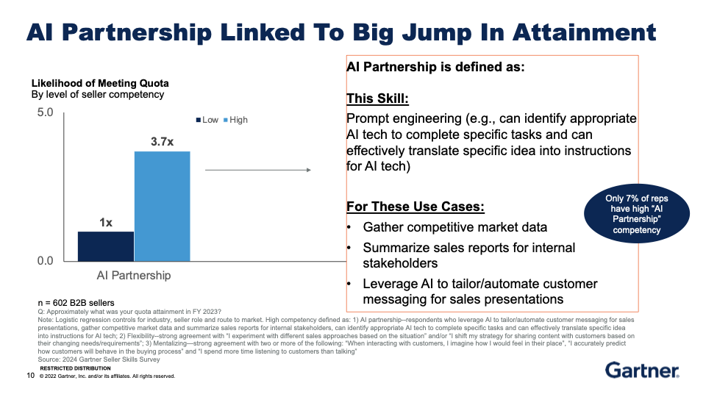
2. AI Partnership = an emerging sales tech competency

Slide 30
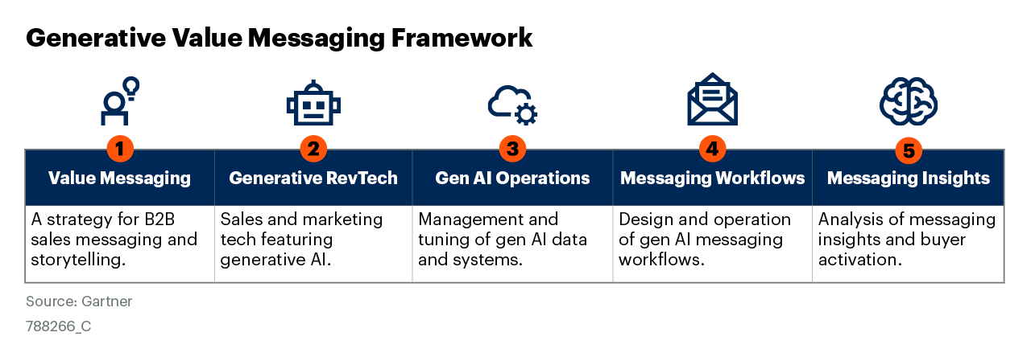
3. Generative Value Messaging is emerging to lower CAC with AI

Slide 31
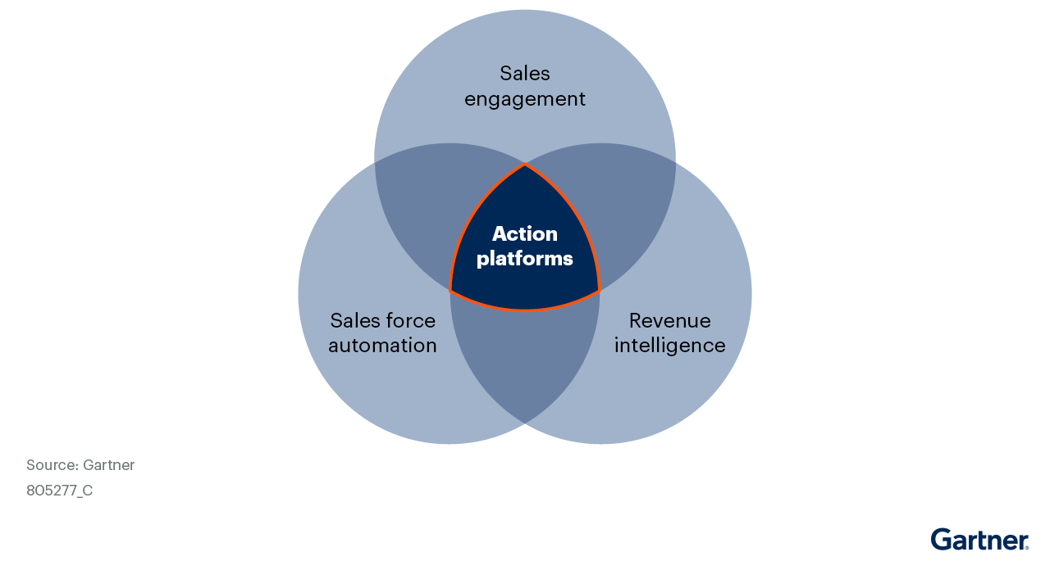
4. Sales Tech Mayhem: Market Convergence Around Action Platforms

Slide 32
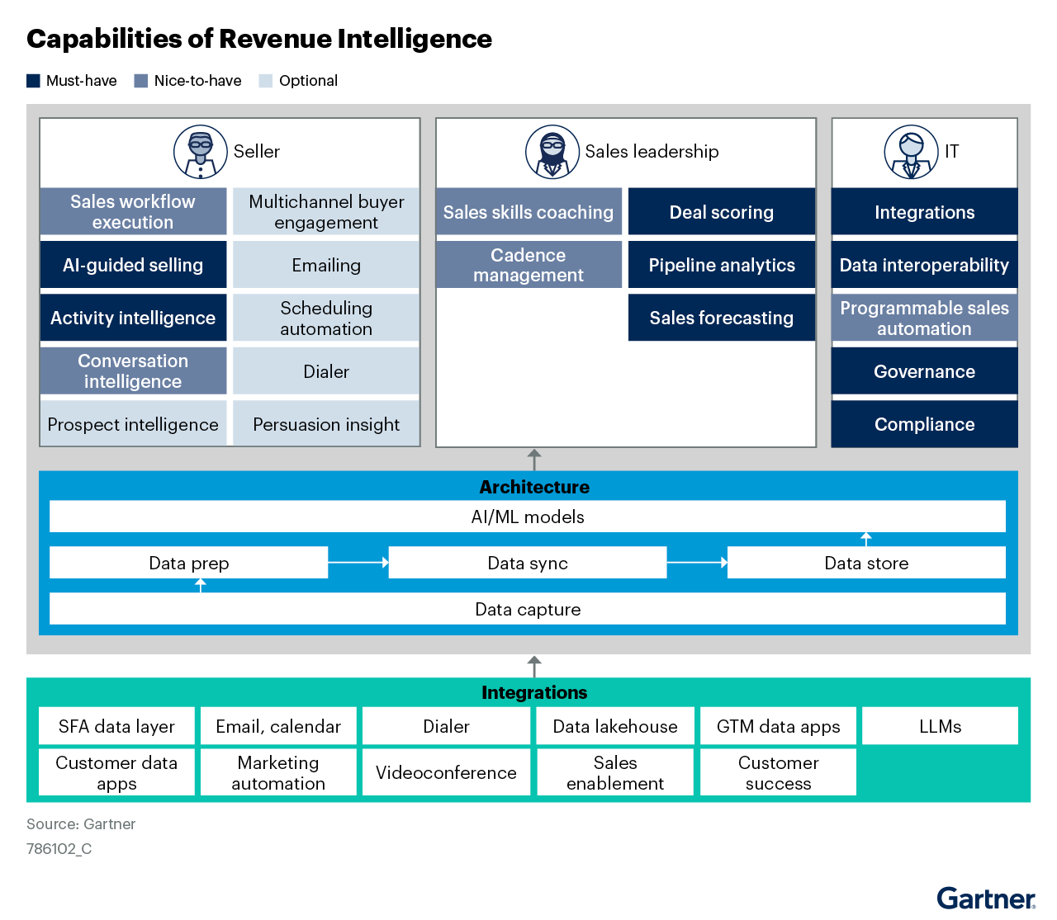
5. Hello, Action Platforms
The Big Bet Behind Action Platforms
CONSOLIDATED SALES ACTIVITY MODEL

Slide 33
5. Hello, Action Platforms Noteworthy Capabilities: Sellers
Multi-channel engagement
AI-Guided Actions
Sales AI Assistant
Buying Intelligence
Leadership/ Ops
Action Orchestration
Advanced Activity Intelligence
Deal Scoring
Pipeline Analytics

Slide 34
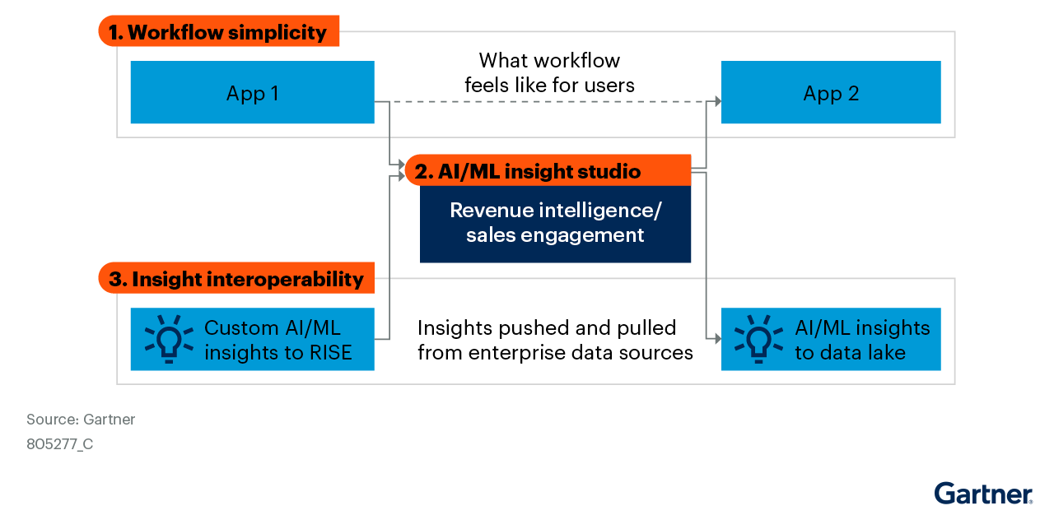
6. Workflow and Data Interoperability are Key Vendor Differentiators

Slide 35
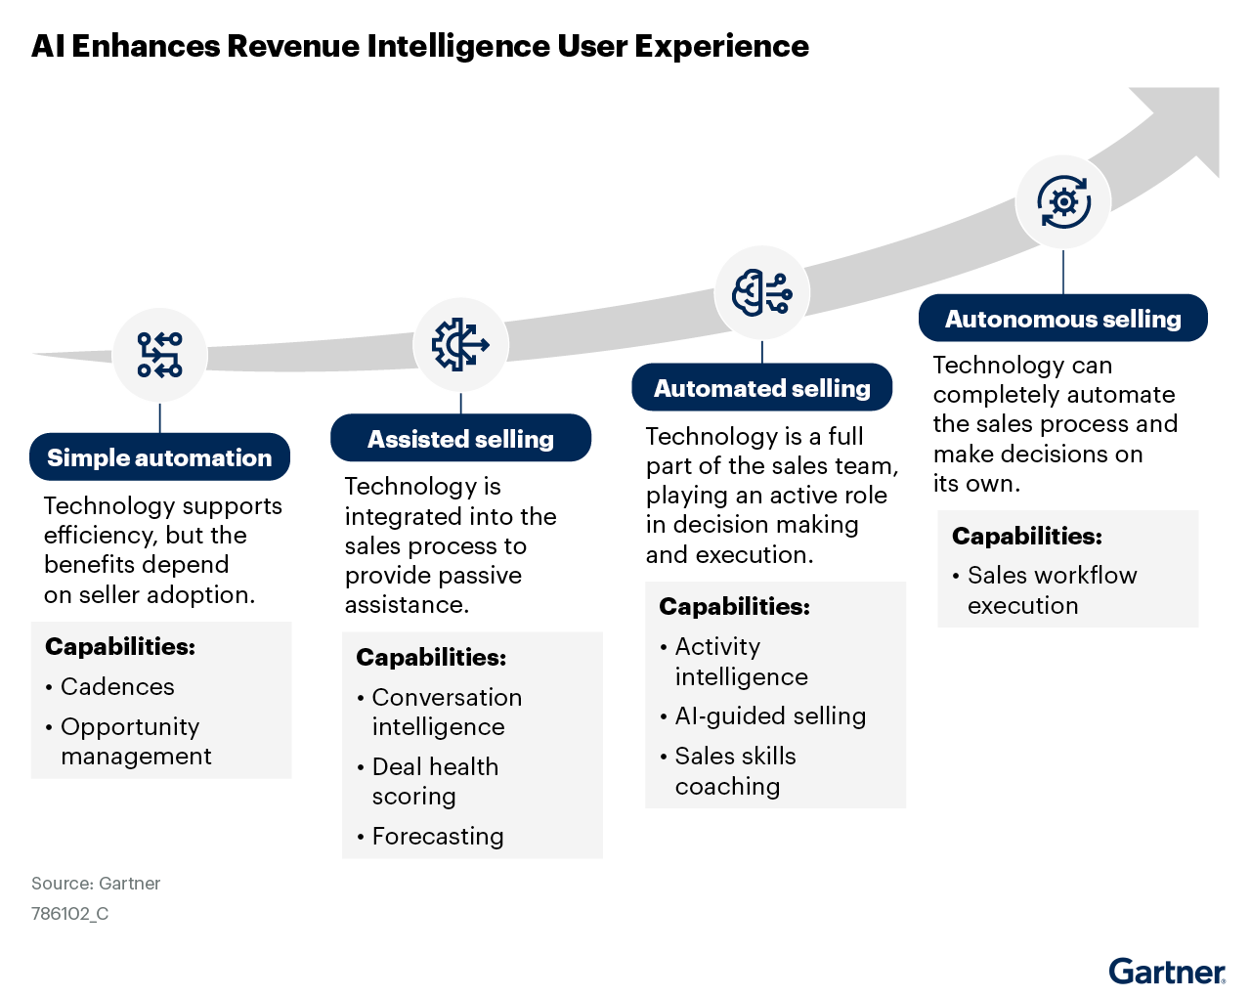
7. We are beginning a UX transformation in sales tech. Early adopters will earn a significant competitive advantage.

Slide 36
Dan’s 7 Sales Tech Takeaways
Reps are partnering with AI across the sales process now
Reps with AI partnership skills are 3.7x more likely to hit their number
Generative Value Messaging is a new GTM operating model
Significant sales tech players are converging into “Action Platforms”
“Action Platforms” will deliver frontline productivity ($/rep) gains with AI
The differentiators: workflow and data interoperability
Innovation in UX will address the sales tech adoption problem

