Slide 1
Revenue Operations Council

Slide 2

We help our portfolio build and optimize hyper-growth GTM machines

Slide 3














The GTM platform leverages our expert network to provide a suite of offerings
Educational / Networking Events
Advisory
Content
GTM
Network
Experts in sales and marketing across the startup growth lifecycle

Slide 4
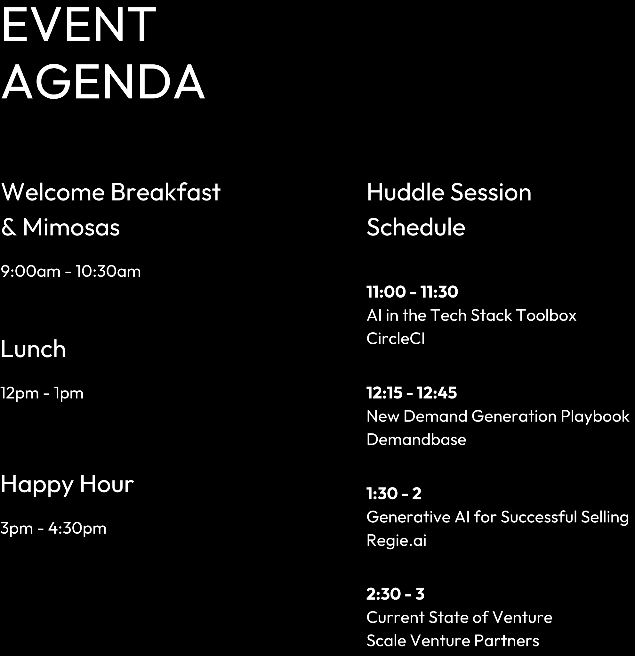
Join us at our Dreamforce event
September 13th
9:00am - 4:30pm
We’ll have small group huddles throughout the day, with guests from our portfolio, GTM network, and investment team. Stop by for a quick hello, or linger. We’ll be there all day.

Slide 5
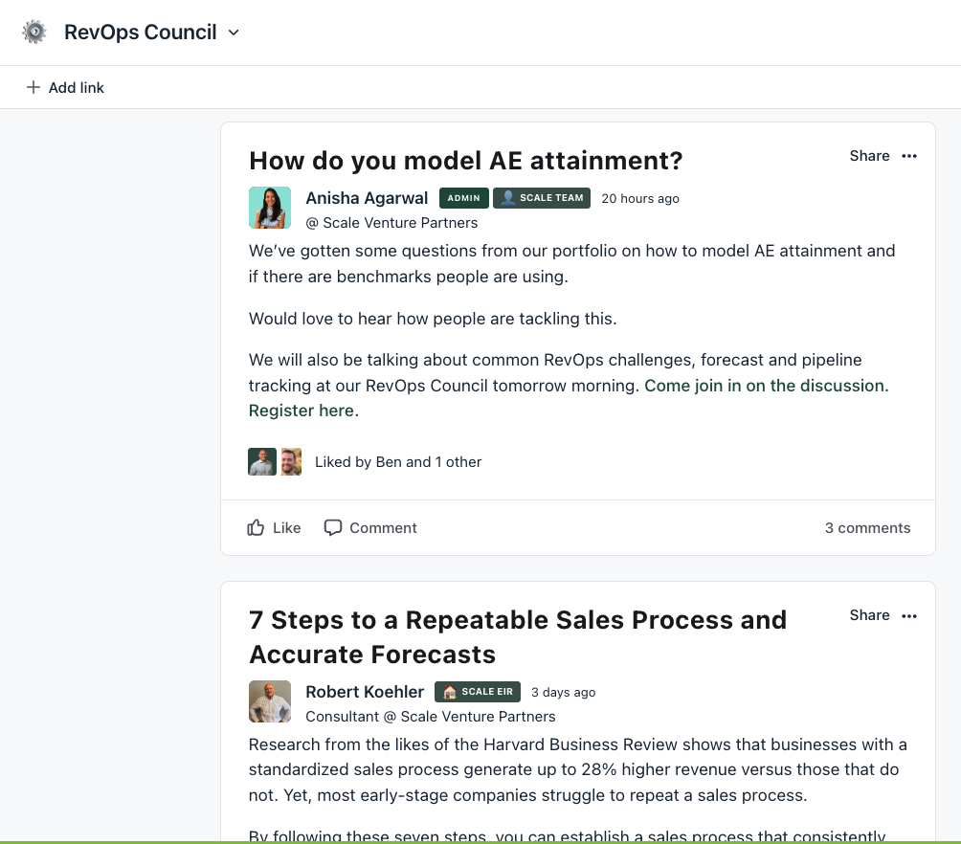
The RevOps community is live

Slide 6




Our facilitators
Craig Rosenberg
Chief Platform Officer
Scale Venture Partners
Ben Loeffler-Little
VP of Sales Strategy,
Operations, & Enablement
Model N
Michael Hargis
Head of Revenue Operations
Tealium
Anil Somaney
SVP of Revenue Operations
Chargebee

Slide 7
The RevOps Playbook

Slide 8
Key Pillars of Revenue Operations
Strategy | Process | Workflow
Plan that aligns to revenue objectives to organize and mobilize the revenue organization: RevOps Strategic Charter Revenue Model GTM Strategy Organizational Design Stakeholder Alignment Resource Prioritization Data-Decision Framework | Design, management, and tracking of end-to-end revenue processes: Customer Lifecycle Map Segmentation Revenue Process Design Milestone Alignment and Definitions Service Level Agreements | Manual and automated processes required for an interconnected revenue process: Workflow Design Hand-offs Joint Processes Closed-Loop Processes
Data | Analysis | Technology
Data needed to manage and optimize end-to-end revenue processes: Data Strategy and Governance Data Collection Shared Data | Agreed-upon activities to monitor and measure across the revenue lifecycle: Metrics and Reporting Alignment Forecast Analysis Pipeline Health Analysis Funnel Conversion Analysis Customer Health Analysis | Technology stack required for Revenue Operations execution: Tech Stack Design Core Infrastructure Data Workflow Artificial Intelligence/ Machine Learning Activity Capture Reporting and Dashboards Usage and Enablement
Source: TOPO RevOps Framework

Slide 9
Why is this important?
Great businesses are built week-by-week, month-by-month. Long term strategic plans and financial models are great and serve a purpose but it’s the consistent execution each week that moves the needle on delivering results and creating value.
When building out your rev ops playbook for sales performance and analysis, it’s helpful to start with a simple question of “Did you have a good week or a bad one?”
Unfortunately, for many businesses, the leadership teams don’t have an easy way to answer that question…today we’re going to discuss some best practices and suggestions for getting this in place.

Slide 10
Where do we start?
We think there are primarily three key questions that matter the most:
Retention - Are we keeping and growing the customers that we have?
Conversion - Are we giving ourselves a chance to hit our sales number this quarter by converting the pipeline we have?
Creation - Are we creating enough new opportunities to hit our sales number next quarter?

Slide 11
Answering Question #1: Churn / Expansion Forecast
Frequency | Revenue Moment | Description | Key Metrics
Weekly | Current Quarter Renewals | Roll up from each team. You should have a churn “budget” to draw down against. Special focus on accounts within 6 months of renewal and for Red and Yellow accounts where renewals are at risk. | Account health, renewal dollar value (best case, worst case, most likely)
 | Current Quarter Expansion | Roll up from each team. Special focus on accounts that landed small, on larger companies with a relatively smaller spend, or multi-division accounts where you can replicate success | Account health, renewal dollar value (best case, worst case, most likely)
Bi-weekly | Next Quarter Renewals | If you rely on in-quarter closes for a large percentage of your revenue, keep close tabs on the early-stage deals to give advance notice if your in-quarter funnel is changing | Account health, renewal dollar value (best case, worst case, most likely); Mid-funnel stage coverage
 | Two Quarters Out Renewals | How long does it take your team to move to move an account from Red to Green? That’s the BARE minimum for how far ahead to look long ahead of renewals you | Account health, renewal dollar value (best case, worst case, most likely)
 | At Risk Accounts | Quantity which major deals are at risk and devise a save strategy. Look for commonalities across red accounts, or any major changes in selling environment that will impact buyers. | Account health, renewal dollar value (best case, worst case, most likely)
Source: Clari Revenue Cadence Playbook

Slide 12
Answering Question #2: New Bookings Forecast
Frequency | Revenue Moment | Description | Key Metrics
Weekly | Current Quarter | Roll up each FLM’s forecast by Worst Case / Call / Best Case. Beware of making decisions on stale data: Make sure everyone is keeping their deals up to date and commit to updating on the same day of the week. If an FLM is overriding their team’s forecast, explain why and take notes so you all remember the thinking in later meetings. | Best case; Worst case; Most likely (Call)
 | Major Deals | Leading indicators are infinitely more valuable than lagging indicators. Always look for risk in major deals even at early stages, checking for relationships, insights and resources that be brought in the moment any risk is spotted. | SOE; Stage progression; MAP Status; Executive Engagement
Bi-weekly | Next Quarter (Q+1) | If you rely on in-quarter closes for a large percentage of your revenue, keep close tabs on the early stage deals to give advance notice if your in-quarter funnel is changing. | Best case; Worst case; Most likely; Pipeline coverage (mid-funnel) In Quarter deal value vs. last Quarter / last Year; Current Quarter deals at risk of slip (that may get pushed into Next Quarter);
 | Two Quarters Out (Q+2) | Unless you have a very fast sale cycle, you need to be forecasting 2+ quarters out to give the team enough time to change direction if there’s a problem. | Best case; Worst case; Most likely; Pipeline coverage (early and MQL incoming)
Source: Clari Revenue Cadence Playbook

Slide 13
Answering Question #3: Funnel Analytics
Frequency | Revenue Moment | Description | Key Metrics
Monthly | Trend Check | In dynamic conditions, the ground shifts fast. Use your revenue platform to compare QoQ for key metrics. If close rate, top of funnel or time in stage is changing rapidly the faster you understand the causes, the faster you can adapt. | Current vs. last quarter comparison for Close rate; S0-S1 advancement rate; S0 count & dollar value
Quarterly | Closed-Lost Analysis | Segment your data by team. In early stage, if only some teams have problems, then look at enablement. If everyone is seeing a decline, then Marketing may need to adjust their ICP or MQL criteria. Late stage lost is more expensive. Use CI analysis to dig deeper than the dropdown of closed-lost reasons and spot trends that you can address: lax mid-stage process, lack of mid-late funnel collateral, poor business case or CFO engagement. | Closed lost at stage; Closed-lost reason; Conversation smart summaries; MAP status at close
 | Pipeline Council | Meet with Demand Gen and Enablement teams and construct a strategy to address weaknesses in pipeline generation. Demand can deliver better leads, Revenue teams can run targeted plays, Product can fix friction points, Competitive can improve positioning, Enablement can teach better objection handling. Measure the impact on your KPIs, reporting monthly in Pipeline Council and adjusting as necessary. | Current vs. last quarter comparison for each KPI you identified, but any leading indicators for those KPIs.
Source: Clari Revenue Cadence Playbook

Slide 14
Quarterly Business Reviews (QBRs) provide an opportunity to go deeper
Frequency | Revenue Moment | Description | Key Metrics
Quarterly | Root Cause Analysis | Dig into opportunity details to understand why assumption(s) are off. Can underperformers be fixed or can you boost any of the other levers enough to compensate? How long will it take to see the impact of any change? What does that mean for your “new normal”? | Usage data; Account Status
 | Assumption vs. Actual | Measure win rate and ASP (average selling price) vs. actuals. Look at a trailing 5 quarters to understand rate of change. What’s worst case and when does it hit? | Change over time of Win Rate & ASP by segment
Bi-annually | Reprioritize KPIs | Pure QoQ growth is good in a 0% interest economy, but in tighter macro, you need to focus more on net dollar retention of customer base, close rate (assuming reduced top of funnel) and COGSs. Make sure the KPIs you report on match the new normal | Customer strategic initiatives; Progress towards partnership goals
 | Reset Goals | Given the new normal, is there a path to plan? Reset SDR comp and Marketing goals to drive the new behavior you identified in the RCA. Reset rep attainment / comp plans based on what’s attainable or risk a demoralized team who totally flame out and can’t even deliver what’s possible. | Usage data; Account Status; Whitespace / Additional value; Customer strategic initiatives
Source: Clari Revenue Cadence Playbook

Slide 15
How to keep the Executive Team and Board informed:
Frequency | Revenue Moment | Description | Key Metrics
Weekly | Executive Staff Forecasting | Roll up the forecasts from your leaders and pressure test until you’re confident, then share your Best / Worst/ Most Likely with your company’s executive staff every week. Be as accurate as possible and don’t hide bad news. | CURRENT QUARTER (by segment or region) New Logo; Net Dollar Retention Best / Worst/ Most Likely NEXT QUARTER (by segment or region) Pipeline coverage; New Logo; Net Dollar Retention Best / Worst/ Most Likely TWO QUARTERS OUT (by segment or region) Pipeline coverage; Long range forecast
Monthly | Board Flash | There should be no surprises at the actual board meeting. Set expectations with a short note each month reporting performance against plan. Spend more time on risks than accomplishments.
Quarterly | Board Meetings | Yes, you need to share results, but the why is more important. Break down KPIs by segment or region to illustrate differences in performance or highlight upcoming risk. After reporting actuals, show pipeline and next quarter forecast. If you’re seeing changes in the assumptions powering your financial model, share the trends and what you’re changing in response.
Source: Clari Revenue Cadence Playbook

Slide 16
6 Essentials for Predictability

Slide 17
Only 15 percent of revenue leaders are very satisfied with their forecast process
The 2021 State of Sales Forecasting

Slide 18
6 essentials for predictability (that you may not have thought of)
The type of company matters i.e. the ICP
How you sell matters (you can’t close deals without impact)
Stakeholder maps are silent killers
Sales process design tells you where you are and what should happen next
If no one knows what an opportunity is, how can you forecast it?
One of the biggest issues in forecasting: the human process

Slide 19
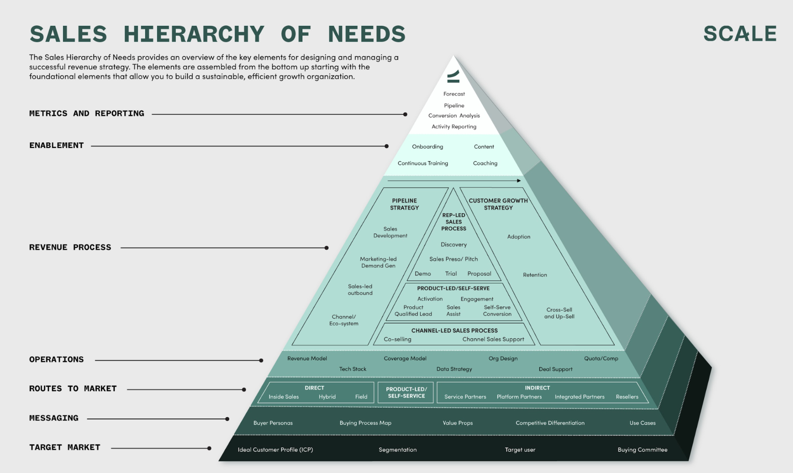
The sales hierarchy of needs

Slide 20
1. The sales hierarchy of needs starts with the ICP
The sales hierarchy of needs
Everything starts here

Slide 21
ICP: the best accounts to sell to (more winnable, faster)
Characteristic | Attribute | Example
Firmographic | Segment / Revenue | Super Regional & Money Center Banks ($50B- $500B in assets) Regional Banks ($5B - $50B in assets) Community Banks (<$5B in assets)
 | Geography | United States and Canada
Environmental | Firmographics | Have purchased or are open to SaaS solutions
Behavioral | Acquisitions | Net acquirers
 | Financial Performance | Strong balance sheet performance

Slide 22
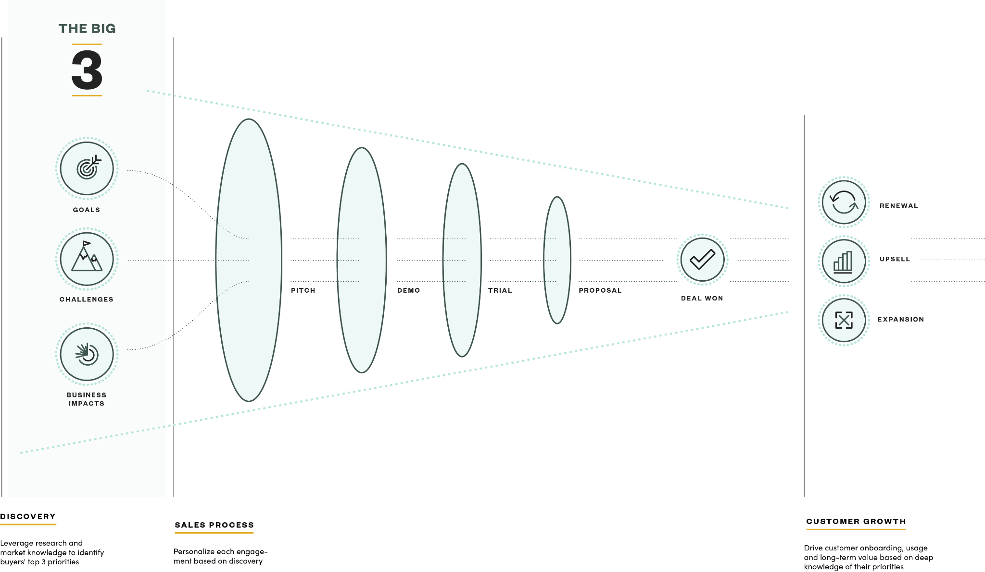
2. Sell to impact or lose deals
Notes:
CR: We can workshop any of these for you. Email Anisha

Slide 23
2. Discovery is often where the deal leakage problem lies
Example
Goal The business goal that the buyer is trying to solve | The Big 3 Challenges Buyer’s barriers to solving the pain or achieving the goal | Impact Consequence of not solving the challenge or seizing the opportunity | Impact Rating 1-10. 10= Critical Impact, 1= Low Priority | Potential Solution Solution to each challenge
Improve Marketing ROI by accelerating the content lifecycle | Everyone working on different systems | No central, searchable view of all assets and content | 6 | Central content management system
 | Approvals take too long | 4-6 week delays in final marketing materials | 8 | Automated approval system with daily alerts
 | No central tracking mechanism | No ability to see what’s behind schedule | 8 | Reporting to proactively identify potential delays and save money by eliminating unused assets

Slide 24
2. Focus proposal presentations on impact, win more
Example
Section | Content
Opening (The Customer) | Executive Summary
 | Recap of the Big 3
Solution (Our Solution) | The Product Solution
 | The Customer Success Plan
 | The People Solution (name, role, picture of team member responsible for their success)
Closing (Pricing) | Pricing
 | Appendix (for additional solution details and any proposal longer than six slides or pages)

Slide 25
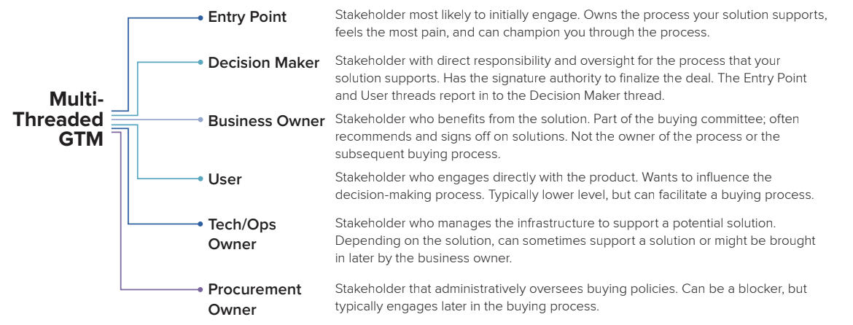
3. The stakeholder map is a silent forecast killer

Slide 26
3. Understand the different stakeholders and build content and tools for them
Thread | Role | Strategy | Tool
Entry Point (User) | FP&A: Manager and Director | Primary focus of engagement | Pitch deck Demo
Decision Maker | CFO, VP of Finance | Get intro through entry point Engage directly (focus on strategic messaging) | ROI tool Customer use cases
Business Owner | Consulting/Service Operations, GM | Get entry through entry point Engage through marketing | Deck: Why GMs care about ….

Slide 27
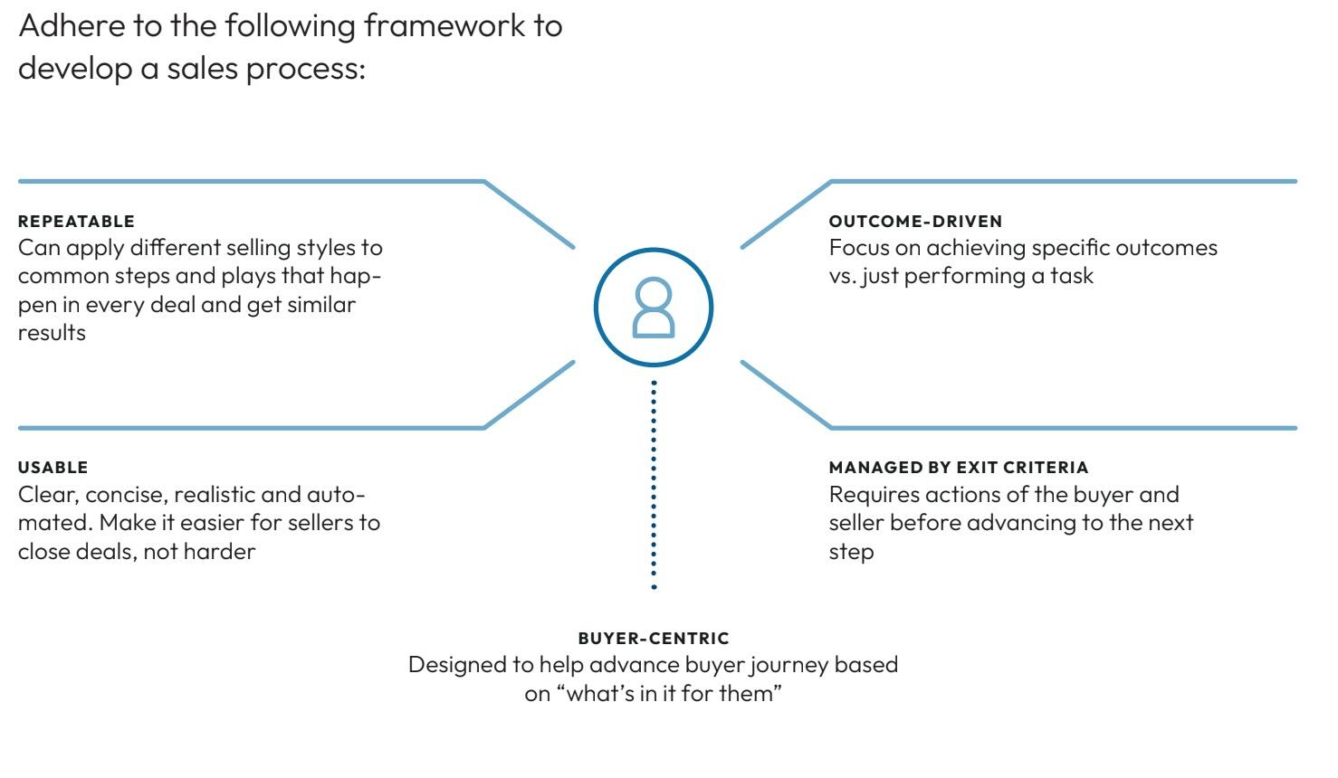
4. Sales process is the roadmap for <forecasting>winning deals

Slide 28
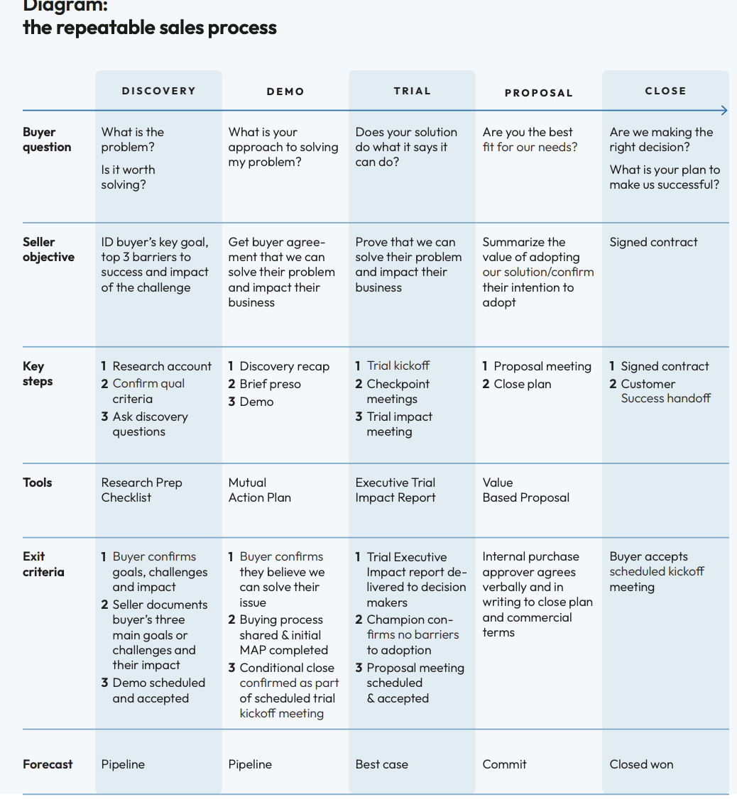
4. Focus on exit criteria

Slide 29
5. Everything else is defined…but opportunities?
Target Accounts
Engaged Accounts
Sales Qualified Leads
Organizations define SQL, MQL, etc but rarely define the opportunity? This creates forecast conflict
Opportunities
Closed-Won

Slide 30

Opportunity definition = the elements of a great deal
M | Metrics | The data that measures your solution’s value to customers. What financial benefit does it offer?
E | Economic Buyer | A profile for who holds the purse strings, whether it’s a single person or group of people. Who makes the buying decisions?
D | Decision Criteria | Your buyer’s checklist of criteria. How are they judging your solution?
D | Decision Process | The path your buyer will take from awareness into decision making. What is your buyer’s process?
P | Paper Process | Any pieces of the decision journey that need to be catalogued and followed. How are you keeping the paperwork in order?
I | Identify Pain | Pain points you have identified and pre-empted with your solution. What does this solution solve?
C | Champion | The foremost authority within your customer’s organization. Who has power, influence and credibility?
C | Competition | Other players in the market competing for the same customers. Who are your competitors?

Slide 31
Systematize the when, where and how inspection
Frequency | Revenue Moment | Description | Key Metrics
Weekly | Prospecting & Strategic Account Penetration | Never let prospecting slip, even if there are lots of in-flight deals. Look at activity metrics, but judge on outcomes and encourage Reps to disqualify bad deals as fast as possible. | Outbound calls, emails, social touches; Accounts touched; Opportunities created; Pipeline created; Pipeline coverage ratio
 | In-flight Deal Review | Make sure rep has qualified the opportunity against your org’s qualification framework, not just feelings. Managers should commit to reading the rep’s deal notes in advance of the meeting. This avoids wasted time “reporting the news” and shows reps that capturing notes isn’t just busy work. | Buyers engaged; Next meeting date; Days in stage; Total deal length
Bi-weekly | Committed Deal Review | Pressure-test every deal in the commit: what’s the steps to close? What’s the best and worst cases, any pull forwards to cover potential slips? [Consider running weekly in final month of quarter.] | Total Committed Revenue; Best Case / Most Likely / Worst Case forecasts
 | Sales Skills Review | Review calls together and focus on a specific selling skill like active listening, multithreading, asking for the next yes, establishing a POV etc. | Stage conversion rates; Quota attainment; Sales cycle duration; Win rates; ASP [Compared to peer benchmarks]
Monthly | Career Conversations | Every seller needs a career path. Check in once a month to make sure they’re moving forward on their own path and that they’re satisfied with progress. | Percentile performance across team
Source: Clari Revenue Cadence Playbook

Slide 32
Standardize deal reviews
OPPORTUNITY DETAILS
The BIG 3
PRIORITY ACTION ITEMS
DEAL DETAILS
Link to CRM Record
Account Name
Brief Strategic Company Overview
Estimated Deal Size
Current Sales Stage
Competition (Vendors, projects, individuals, departments or initiatives competing for the same budget)
Why would we lose / buyer would ‘do nothing’?
Timeline to move and why
Close Date in CRM:
GOAL | CHALLENGE Challenges to meeting objective | IMPACT Implication of not solving challenge | IMPACT RATING (1= Low priority, 10= Critical Impact) | SOLUTION Solution to each challenge
Priority | Priority Action | Owner | Deadline
#1
#2
#3
BUYING PROCESS & BUYING COMMITTEE DETAILS
Economic Buyer (the people, person or group that has the overall authority in the decision process)
Champion
Budget Approval Process | Individual Manager / Director discretionary budget: $_________ Amount requiring higher level approval: $_________ Amount requiring CFO approval: $__________

Slide 33
6 essentials for predictability (that you may not have thought of)
The type of company matters i.e. the ICP
How you sell matters (you can’t close deals without impact)
Stakeholder maps are silent killers
Sales process design tells you where you are and what should happen next
If no one knows what an opportunity is, how can you forecast it?
One of the biggest issues in forecasting: the human process

Slide 34
Breakouts

Slide 35
Example: Funnel Analysis over Time (Lead based view)
 | Q123 | Q223 | Q323 | Q423 | 2023
Leads
% to MQL
MQLs
% to in Qtr. SQL
SQLs
% to Opp
Opportunities
% to Won
Won

Slide 36
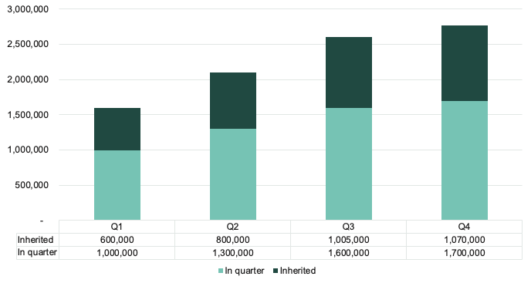
Trending Pipeline Analysis

Slide 37
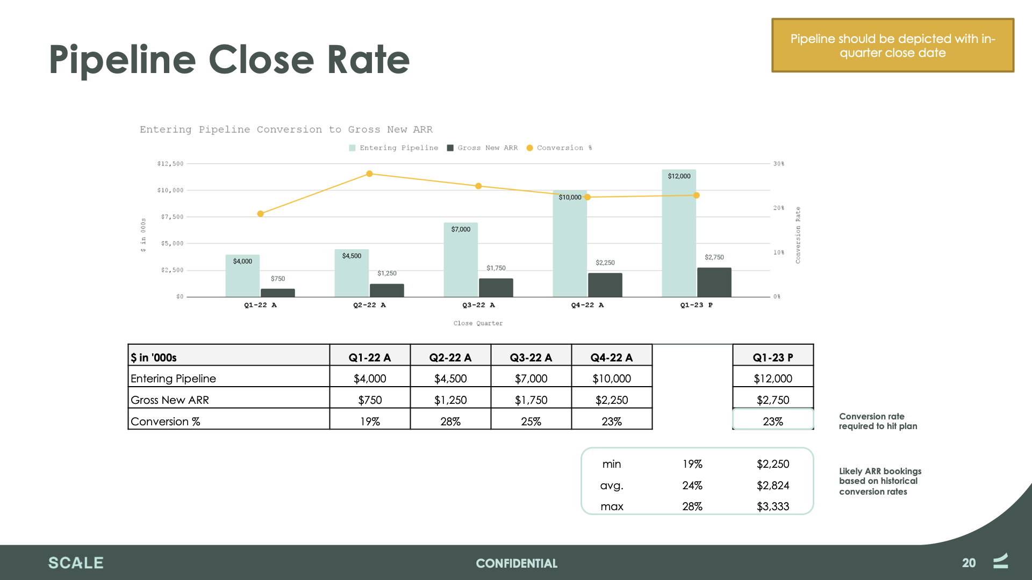

Slide 38
Roll up of forecast by business and region
NAME | QUOTA | GAP TO GO | CLOSED | WORST CASE | CALL | BEST CASE | PIPELINE COVERAGE | CALL COVERAGE
Overall | 9,000,000 | 656,658 | 656,658 | 7,100,000 | 8,650,000 | 9,500,200 | 15,111,433 | 2.0x
Region 1 | 2,000,000 | 252,070 | 252,070 | 1,500,000 | 1,950,000 | 2,200,200 | 3,987,125 | 2.3x
Region 2 | 1,800,000 | 205,868 | 205,868 | 1,400,000 | 1,600,000 | 2,000,000 | 3,423,876 | 1.9x
Region 3 | 5,200,000 | 198,720 | 198,720 | 4,200,000 | 5,100,000 | 5,300,000 | 7,700,432 | 2.0x

