Slide 1
Marketing council: How to craft a great marketing plan
2025

Slide 2
Today’s agenda
Welcome & introduction
Principles & process for designing a marketing plan
Templated plan
Bonus: Sign up for a jam session!

Slide 3
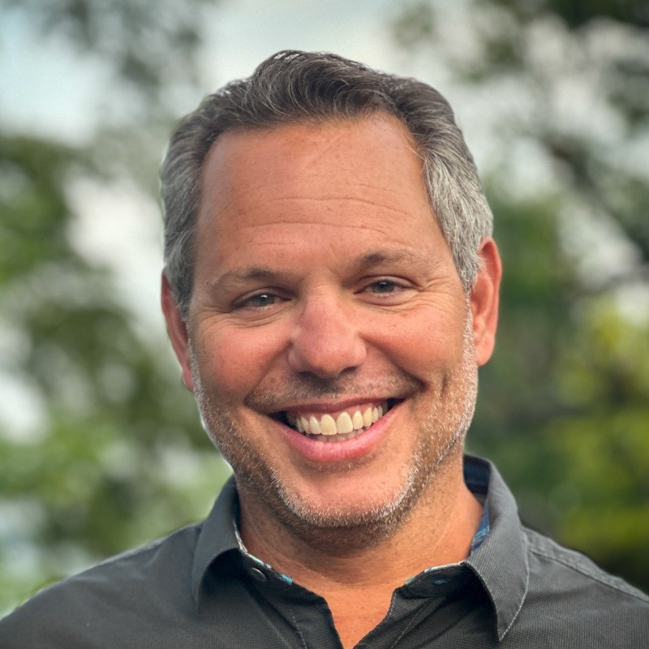
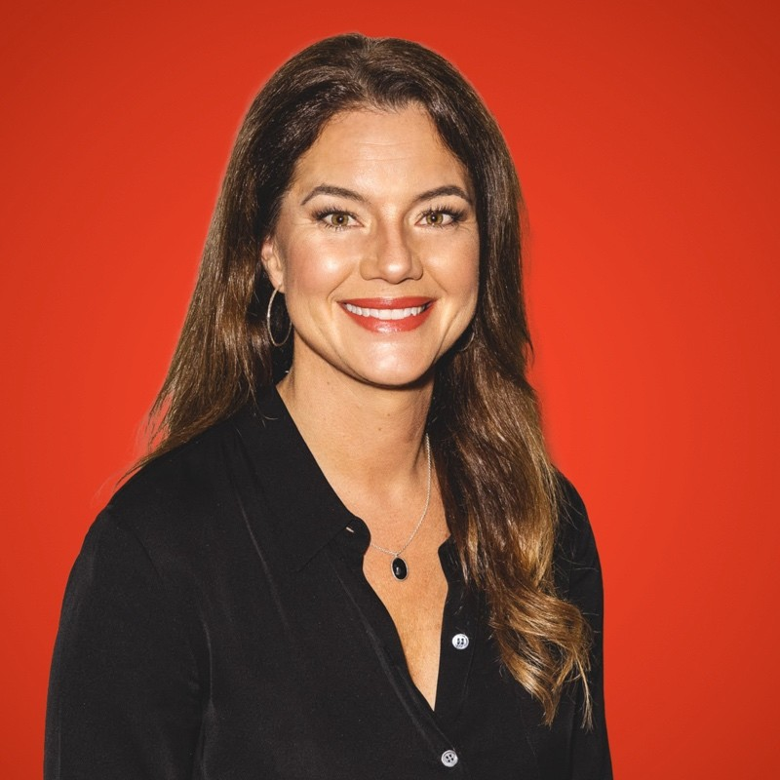
Jam sessions: 2026 marketing planning
Why
What
Validate strategic choices around ICP, positioning, and messaging
Review the assumptions and research behind your plan
Prioritize critical activities for 2026
Uncover potential gaps in your plan
Assemble advisory resources to help you attain your plan goals
1-2 hour live review session (please send us your marketing plan in advance)
Who
Pete Giordano Scale CMO EIR
Sydney Sloan Scale CMO EIR
Notes:
‹#›

Slide 4
Principles & Process

Slide 5
5 characteristics of a great plan
1
It contributes to the company plan (aligned w/ CEO)

Slide 6
5 characteristics of a great plan
1
It contributes to the company plan (aligned w/ CEO)
2
It’s metric-driven (aligned w/ finance)

Slide 7
5 characteristics of a great plan
1
It contributes to the company plan (aligned w/ CEO)
2
It’s metric-driven (aligned w/ finance)
3
It’s GTM-oriented (aligned w/ sales & product)

Slide 8
5 characteristics of a great plan
1
It contributes to the company plan (aligned w/ CEO)
2
It’s metric-driven (aligned w/ finance)
3
It’s GTM-oriented (aligned w/ sales & product)
4
Your leaders can execute it

Slide 9
5 characteristics of a great plan
1
It contributes to the company plan (aligned w/ CEO)
2
It’s metric-driven (aligned w/ finance)
3
It’s GTM-oriented (aligned w/ sales & product)
4
Your leaders can execute it
5
ICs understand how what they do supports the plan

Slide 10
How the planning processes build on each other
OKRs
Department Annual Operating Plans
Company Plan - Portfolio of Initiatives
Company Core Strategies
Mission, Vision, & Financial Goals
Every layer aligns and sits upon the layer below it, building up from mission and vision, driving all the way to OKRs and what’s most important to execute right now

Slide 11
Start with the planning timeline
We are here
Leadership Team Offsite <date>
Reflection
Performance metrics and goals
Big Ideas!
1H marketing initiatives
AI use case identification
Notes:
‹#›

Slide 12
Start with the planning timeline
We are here
Leadership Team Offsite <date>
Previews & Planning
<date>
Reflection
Performance metrics and goals
Big Ideas!
1H marketing initiatives
AI use case identification
Share initial ideas with departmental teams
Other team or x-functional offsites
PM / PMM launch theme working sessions
Marketing program performance analysis & budget reconciliation
Notes:
‹#›

Slide 13
Start with the planning timeline
We are here
Leadership Team Offsite <date>
Previews & Planning
<date>
Full Team Virtual Workshops
<date>
Reflection
Performance metrics and goals
Big Ideas!
1H marketing initiatives
AI use case identification
Share initial ideas with departmental teams
Other team or x-functional offsites
PM / PMM launch theme working sessions
Marketing program performance analysis & budget reconciliation
Review Marketing team OKR updated goals
Program performance review
Review x-team high priority projects
Update on team health feedback and 2H goals
Notes:
‹#›

Slide 14
Start with the planning timeline
We are here
Leadership Team Offsite <date>
Previews & Planning
<date>
Full Team Virtual Workshops
<date>
Leadership Team OKR Update
<date>
Reflection
Performance metrics and goals
Big Ideas!
1H marketing initiatives
AI use case identification
Share initial ideas with departmental teams
Other team or x-functional offsites
PM / PMM launch theme working sessions
Marketing program performance analysis & budget reconciliation
Review Marketing team OKR updated goals
Program performance review
Review x-team high priority projects
Update on team health feedback and 2H goals
GTM shared goals
Product roadmap / launch alignment (themes!)
Regional alignment w/ sales
Segment / Regional DG plans
Notes:
‹#›

Slide 15
Sample timeline
We are here
Leadership Team Offsite <date>
Previews & Planning
<date>
Full Team Virtual Workshops
<date>
Leadership Team OKR Update
<date>
Finalized plan & budget
<date>
Reflection
Performance metrics and goals
Big Ideas!
1H marketing initiatives
AI use case identification
Share initial ideas with departmental teams
Other team or x-functional offsites
PM / PMM launch theme working sessions
Marketing program performance analysis & budget reconciliation
Review Marketing team OKR updated goals
Program performance review
Review x-team high priority projects
Update on team health feedback and 2H goals
GTM shared goals
Product roadmap / launch alignment (themes!)
Regional alignment w/ sales
Segment / Regional DG plans
Key marketing targets & investment finalized
Priority alignment w/ Rev and product teams
2H goals and budget locked
Notes:
‹#›

Slide 16
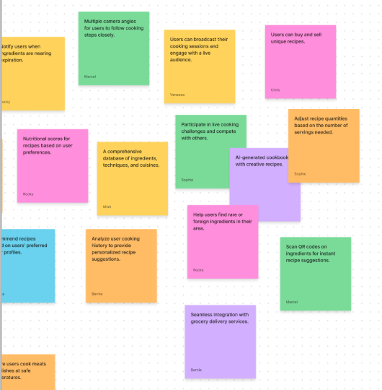
Big ideas workshop
Pre-work
Each leader presents an idea
Brainstorm new ideas
Categorize them
Make it “their idea” and plan
Note: Great exercise to get new ideas on the table before starting to get into the detailed planning

Slide 17
Marketing plan template

Slide 18
What’s included in the plan
Previous Year Highlights & Lessons
Marketing Team Mission / Charter
Company Goals
Marketing Team Goals
Key Initiatives
Organizational Plan (current & future state)
Budget
1
2
3
4
5
6
7

Slide 19
Previous year highlights & lessons learned
You can build this from a Stop / Start / Continue exercise
1
FY Highlights
Roadshows influenced $XXM in revenue and ROI 5x
Implemented X product or agent use cases
New pricing and packaging increased ASP by X%
Customer champions program grew by X%
Built new website experiences that converted X% of Y
Lessons Learned
Cross-functional alignment with…
Program level insights…
Partnerships…
Slow follow up on trade show leads…
Need more customer education on ….
Note: You can build this from a Stop / Start / Continue exercise

Slide 20
Marketing performance - year in review
1
$XX M
$XX M
XX M
$XX M
XXX
Marketing Contributed Pipeline
Marketing Sourced Pipeline
LinkedIn Impressions
Program Highlight (roadshow)
Customer Event Attendees
$XX M
$XX M
XX M
$XX M
XXX
Marketing Contributed Revenue
Marketing Sourced Revenue
Social Media Impressions (or followers)
Customer Renewals Influenced
Reference
Customers
Note: You could also add % improvement yr/yr

Slide 21



New company goals
3
Changes from previous years
Financial Goals
Key Initiatives
Note: For a great primer on setting company-wide goals, check out our whitepaper here

Slide 22
Marketing goals - new
4
$XX M
$XX M
XX M
$XX M
+XX
Marketing Contributed Pipeline
Marketing Sourced Pipeline
LinkedIn Impressions
New Product Revenue
eNPS
$XX M
$XX M
XX M
$XX M
XX K
Marketing Contributed Revenue
Marketing Sourced Revenue
Social Media Impressions (or followers)
Customer Renewals Influenced
Customer Community

Slide 23
Annual marketing plan overview
4
Mission
Establish <company> as the #1 recognized global leader in <category> by customer NPS and market share.
Key Initiatives
Be the Leading Brand
Be the # 1 market leader as measured by share of voice, peer review sites, analyst evaluations and competitive win rates.
10X our Marketing Engine
Build marketing engine to enter new markets, drive engagement and improve pipeline conversions.
Renew the AI First Customer Experience
Reimagine an AI powered customer experience from first touch to ongoing engagement.
Prioritize Team Health
Marketing’s culture is an example to other teams as a model of a high functioning, healthy department.
New brand & activation campaign
Category Leadership
Maintain #1 in analyst & peer reviews
Battle level product positioning
Quarterly integrated launch
Drive increase in website conversions
Inbound marketing engine
Marketing engine performance model
EMEA expansion
Partner co-marketing program
Audit and identify new workflows and tech
Implement Web Agents across customer journey
Create a single learning center on the web
Optimize content for AEO
Launch Customer Summit
Team fulfillment and motivation
New Team Onboarding experience
AI Training & empowerment
Career pathing & role clarity
Personal development plans
Metrics
Brand Awareness / Ranking
Website Conversions, Marketing Sourced Demos / Pipeline / Rev
Response timing, Pipeline influence, Net retention
Emplify score > 80
Teams
(lead, names)
(lead, names)
(lead, names)
(lead, names)

Slide 24
Be the leading brand
5
Initiative | Current State | 1H Projects | 1H Measurement
Launch new brand Owner: Name | Original brand with many interactions in the wild. | Parter w/ brand agency to develop new narrative Inventory all current existing assets Determine phases for roll out Align with website project | Launch influence % of assets updated Customer conference experience
Category Leadership Owner: Name | Lack of influence. Targeted incentivized review campaigns supporting category health model | Phase 1: Identify categories and influencers, scoping, aligning to target personas Phase 2: Launch program across analysts, industry influencers and partners | Engagement in category Category depth Best of Software list Cloud 100
Own Linkedin Owner: Name | Company page focus | Influencer programs Founder / Executive engagement Research publishing strategy Company-wide leaderboard (Sprout Social) | Net new followers Impressions (Employees + Influencers)
New Product Launches Owner: Name | Random acts of effort. | Build launch program & templates Launch theme /innovation story | Customers engaged Beta customers Product usage
Note: This is a high level “plan on a page” concept that can then link to more specific plans

Slide 25
10X our pipeline
5
Program | 1H Projects | 1H Measurement
Campaign Name Owner: name | Build content for full funnel based on value, use cases, personas, product alignment and segments Partner implementation - shared offers, shared webinars, co-hosted events Webinar program - target account, person-focused webinars speaking to the pillars of the R2R playbook Field events - roadshows, lunch and learns, digital experiences | Opps created by program for Target accounts Enable 100% of revenue org on new message and talk tracks Increase closed won attribution Influence 90% of T1 and T2 accounts in the campaign
ABM Program Maturity Owner: Name | Fully implement ABM Predictive Model with SLAs and routing for qualified accounts Focus on building out campaign calendars, nurture programs, and conversion to opportunity for all programs Updated persona research to feed 1:1 and 1:Few ABM campaigns; focus on (target) persona | Engaging >90% of top 1k target accounts with 10+ impressions and seeing stage progression for 20% of them.
Global Field Marketing Owner: name | New Programs: Executive Dinners, breakfasts, gifting: NEW EMEA customer event (Feb) NEW: Partner Offers NEW: Global Roadshow NEW: Quarterly virtual roundtables | Increase Opp to Closed Won conversion by 5% Influence 80% of expansion revenue opportunities

Slide 26
Plan
Themes
Committed
Researching
Q1 |  |  | Q2 |  |  | Q3 |  |  | Q4
Feb | Mar | Apr | May | June | July | Aug | Sept | Oct | Nov | Dec | Jan
 |  |  | Podcast
 |  |  | LinkedIN takeover
 |  |  |  |  |  |  |  |  |  | Webinar
 | Roadshow NY |  |  |  |  | Seattle Ma |  |  |  | Customer Guide
thought leadership theme
thought leadership theme (revised)
Second R2R AI Webinar
Thought
Leadership
Top Trends in XX
State of XX
R2R AI Webinar
State of AI Report
Podcast
Brand+Site Refresh P1
Brand+Site Refresh P2
Brand+Site Refresh P3
Brand Campaign
Brand Awareness
LinkedIN takeover
LinkedIN takeover
Theme
Integrated
Campaigns
Target Account offer
Segment Specific
Webinar
Webinar
Segment # 2
TA Revamp
Segment
Partner Offers
New Offer
Webinar
Best of
Webinar
Upsell Campaign
Virtual Event
Roundtable/ Networking
Customer
Experience
Segment Specific
Customer Roundtable
Customer Event
Upsell Nurtures
Champions Program
Health Check
Office Hours
Li: Retargeting: Open ops + sales priority accs + at risk
EAB
Customer Onboarding Course
Best Practice Guide
Cust. Action Plan Course
Cust. Action Plan Course
Customer Guide
New Product Guide
Cust. Action Plan Course
New Certification
Customer Guide
Education
Newly Funded
Product Audit x2
Exec Dinner
Summer Social
Brand Event
Roadhow LON
Event
.Event
Accel. Event
Events & Field
Partner’s Summit
Event
Roadshow PARIS
Event
NAMER EMEA
Pipeline Accel. Event
Rev Leaders Event
Executive Breakfast
T1 Event
Accel. Event
Accel. Event
Event
Chilipalooza
T1 Event
Event
VIP Dinner
Roadshow NY
Roadshow SF
Roadshow BOS
Golf Event
Roadshow ATL
Event
Holiday Gifting
VIP Event
Launch Theme
Launch Theme
Product
Tier 1 Launch
Q1 Innovation Webinar
Q2 Innovation Webinar
New Pricing
Q3 Innovation Webinar
Q4 Innovation Webinar
Sunset Product

Slide 27
Org design

Slide 28
Org Structure: Current State
Core Objectives:
What are your team’s biggest current investment areas
Key Hires and Structure Changes:
What changes have taken place since your last update?
Key Differences from Previous Plan:
Commentary on the impact of previous changes
6
CMO
Market Strategy, Leadership, Contribution to Revenue
Product Marketing
Demand Generation
Communications and Brand Experience
Customer & Analyst Relations
GTM Strategy
Product Positioning
Pricing / Packaging
Product Launches
Competitive
Partner Marketing
Verticals
Budgeting, Metrics
Account Based
Digital Events
Sponsorships
Webinars
Marketing Ops
Marketing Tech
Paid Advertising
Inbound SDRs
Brand Management
Website
Content Strategy
Creative Services
Public Relations
Social Media
Copywriting
Podcast
Analyst Relations
Customer Advocacy
Reference Program
Case Studies
CAB

Slide 29
Org Structure: Next State – FY27
Core Objectives:
What are the new areas you want to invest and what are the expected outcomes?
Key Hires and Structure Changes:
What specific functions / talent / capacity would you like to add to the team and why?
Key Differences from Previous Plan:
What specific experience are you looking to add? How is AI impacting org? Who are you developing for new roles and what skills are you going to add to the team. How does this contribute to company goals.
6
CMO
Market Strategy, Leadership, Contribution to Revenue
Product Marketing
Digital Experience & Operations
Demand Gen
Brand Experience
Customer & Analyst Relations
GTM Strategy
Product Positioning
Persona
Pricing / Packaging
Product Launches
Competitive
Partner Marketing
Verticals / Solution
Budgeting, Metrics
Website
SEO
Email marketing
Marketing Ops
Data strategy
Marketing Tech
Lead scoring
Inbound SDRs
Account Based
Field Marketing
Digital Events
Sponsorships
Webinars
EMEA expansion
Advertising
Campaign
Lifecycle marketing
Brand Strategy
Content Strategy
Brand Campaign
Creative Services
Public Relations
Social Media
Copywriting
Podcast
Analyst Relations
Customer Advocacy
Reference Program
Case Studies
CAB
Community
User Groups

Slide 30
6
Introduction to the Nine Box Talent Matrix
Enigma High potential/underperforming Maybe in the wrong Job/wrong manger Recommendation: Intervention
Growth Employee High potential/High performance Valued contributor Recommendation: Recognize and develop
Future Leader Highest potential for succession/Top talent Recommendation: Reward, recognize, look to promote, continue to develop
High
Dilemma Potential for one growth level Underperforming/needs more challenge Recommendation: Provide Coaching
Core Employee New to role, core player and contributes consistently at a solid level. Recommendation: Motivate, engage and reward
High Impact Performer Strong contributor Recommendation: Challenge, reward, grow and motivate
Leadership Potential
Medium
Under Performer Has reached job potential and is underperforming Recommendation: Performance manage or exit
Effective Employee Specialized or expert/has reached career potential Recommendation: Engage, focus, motivate
Trusted Professional Specialized, expert, has reached career potential Recommendation: Retain, reward, encourage
Low
Low
Medium
High
Performance

Slide 31
6
<Department> team assessment
High
M. Struggle
A. Goto
S. Star
M. Solid
Leadership Potential
N. Hire
Medium
Low
M. Out
IM. Cool
Low
Medium
High
Performance

Slide 32
6
Talent assessment
Individual |  | L | Current Title | Assessment with areas of coaching | PDP (linked)
xx |  | M7 | xx | xx
xx |  | P6 | xx | xx
xx |  | M6 | xx | xx
xx |  | P4 | xx | xx
xx |  | M7 | xx | xx
xx |  | P4 | xx | xx

Slide 33
Budget

Slide 34
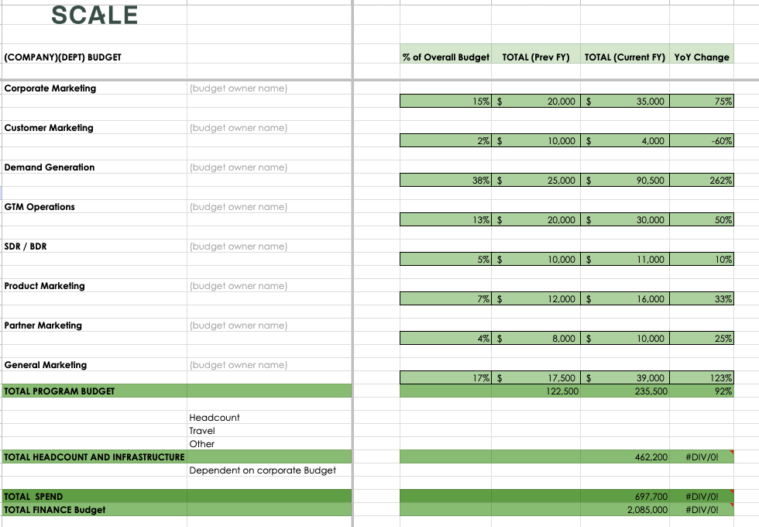
Budget template (here)
7

