Slide 1
Product marketing council Using AI personas to perfect your messaging
2025

Slide 2
What is the GTM Advisory?
Advisory
Library
Events
Been-to-market expertise
Step-by-step guides
The power of community
Advising over 70% of the portfolio with bespoke GTM consulting
Distilling decades of experience into 150+ practical tools and frameworks
Connecting EIRs, advisors, and portcos at 40+ events per year
Notes:
https://www.scalevp.com/gtm-resources/

Slide 3





Scale GTM AI portfolio companies
AI sales engagement platform
Agent-powered ABM
AI avatars
VoiceAI sales agents

Slide 4
Events on the horizon
10 am-11 am Wednesday, July 2nd
GTM AI lab: Bring your own GPT! Kristina McMillan, Scale GTM AI EIR

Slide 5


Join our GTM AI Discord!
Purpose
Join here
A community where GTM leaders from Scale’s portfolio can develop their AI skills, learn from peers, and keep pace
Channels
#general is a place to share articles or LinkedIn posts, swap vendor recommendations, and ask questions
#share-your-prompt is a place to share prompts or workflows you’ve developed
Please do not share this link with anyone outside your company
Notes:
Join our Discord here: https://discord.gg/87ngQWqY
Please do not share this link beyond your company-–we want this to be a space for the portfolio, at least at first

Slide 6

Today’s council speaker
Matt Amundson
CMO, DuploCloud

Slide 7
Using AI personas to perfect your messaging

Slide 8
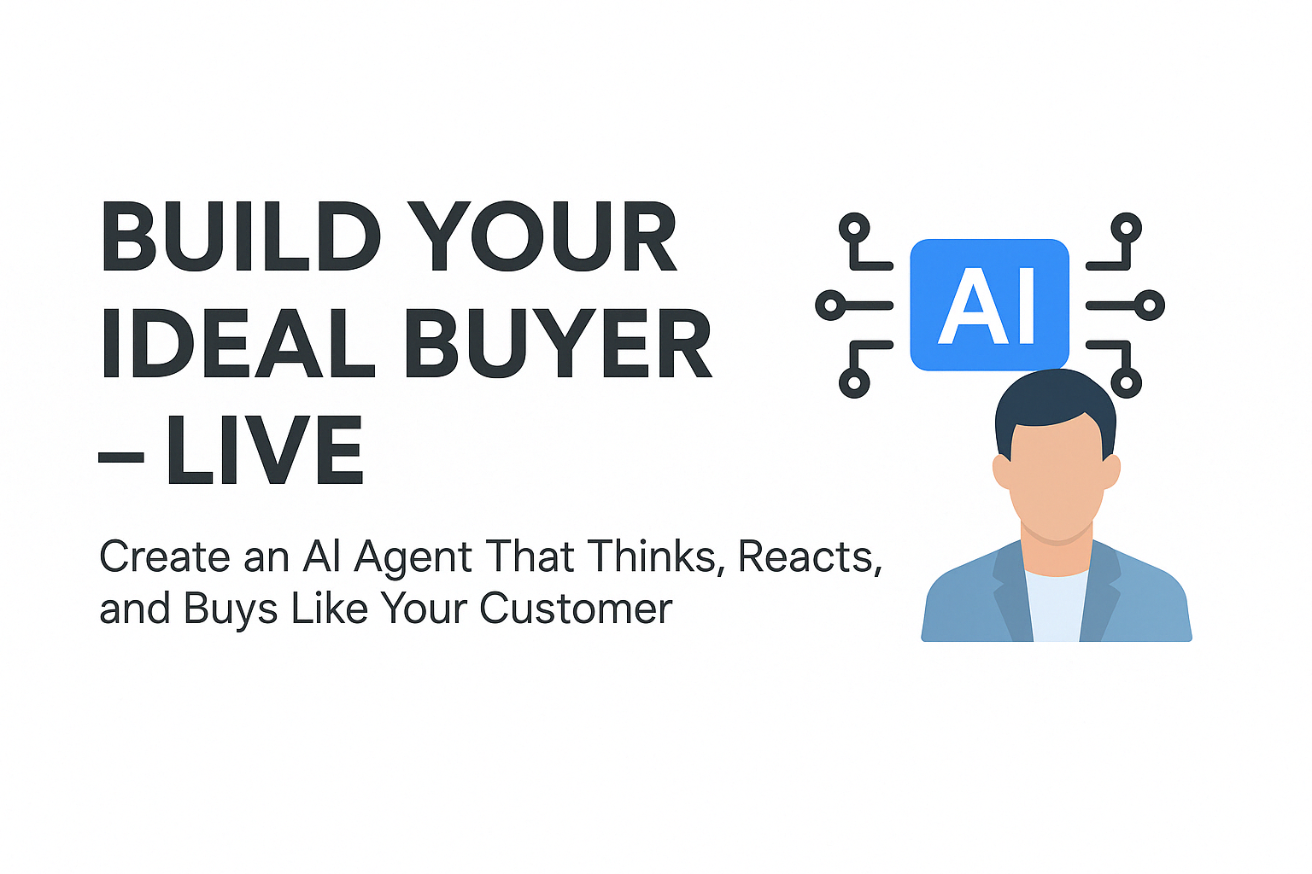
Build AI Agents … it’s easier than you think
I’ve used ChatGPT Plus ($20/month) to create AI Agents built to mimic our typical buying committee
DevOps Engineer
Platform Engineer
VP of Engineering
CTO
Each AI Agent has its own set of characteristics and motivations for purchasing as well as turnoffs towards marketing copy or bold/hyperbolic claims
In turn each agent will return different feedback based on whatever you ask it to analyze (more on that later)

Slide 9
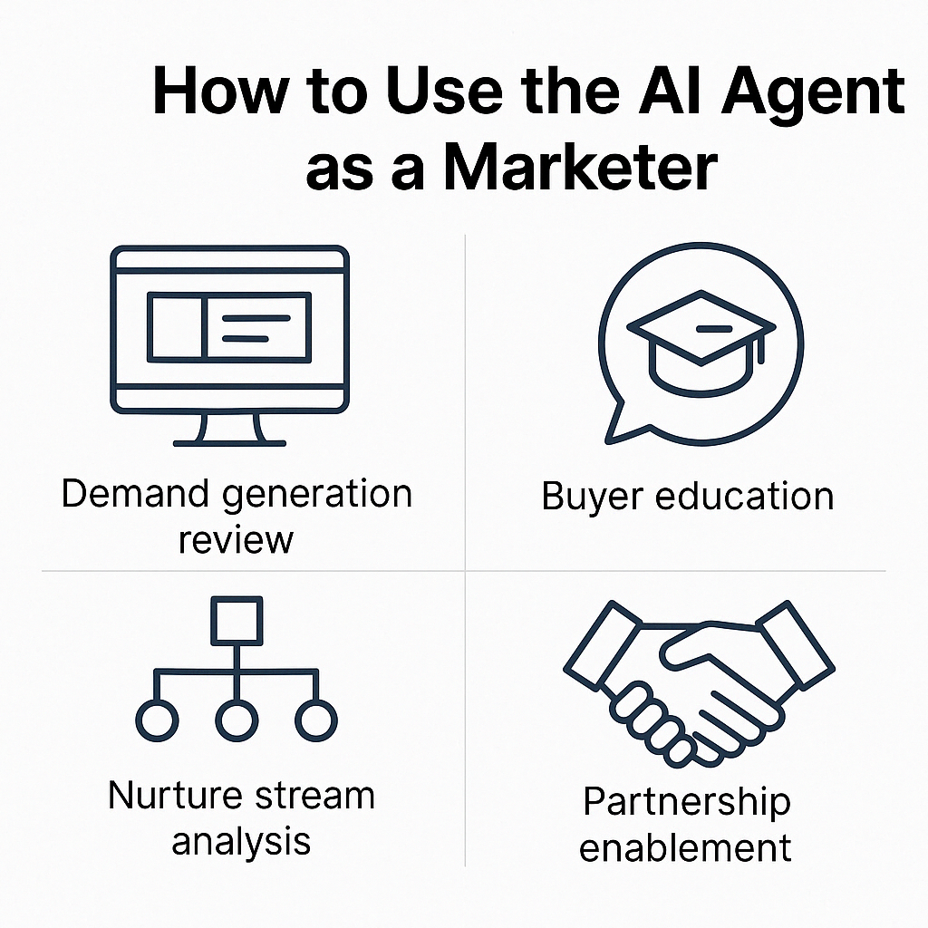
What can I use these Agents for?
In short - just about anything!
So far I’ve used these agents to analyze:
Copy for a new homepage and new product pages
Digital ads and corresponding landing pages
Blog posts
Marketing, BDR, AE emails
Sales Decks
Each agent will return different pros and cons as well as information that they think is missing from the assets our marketing team has created (examples on the next page)

Slide 10
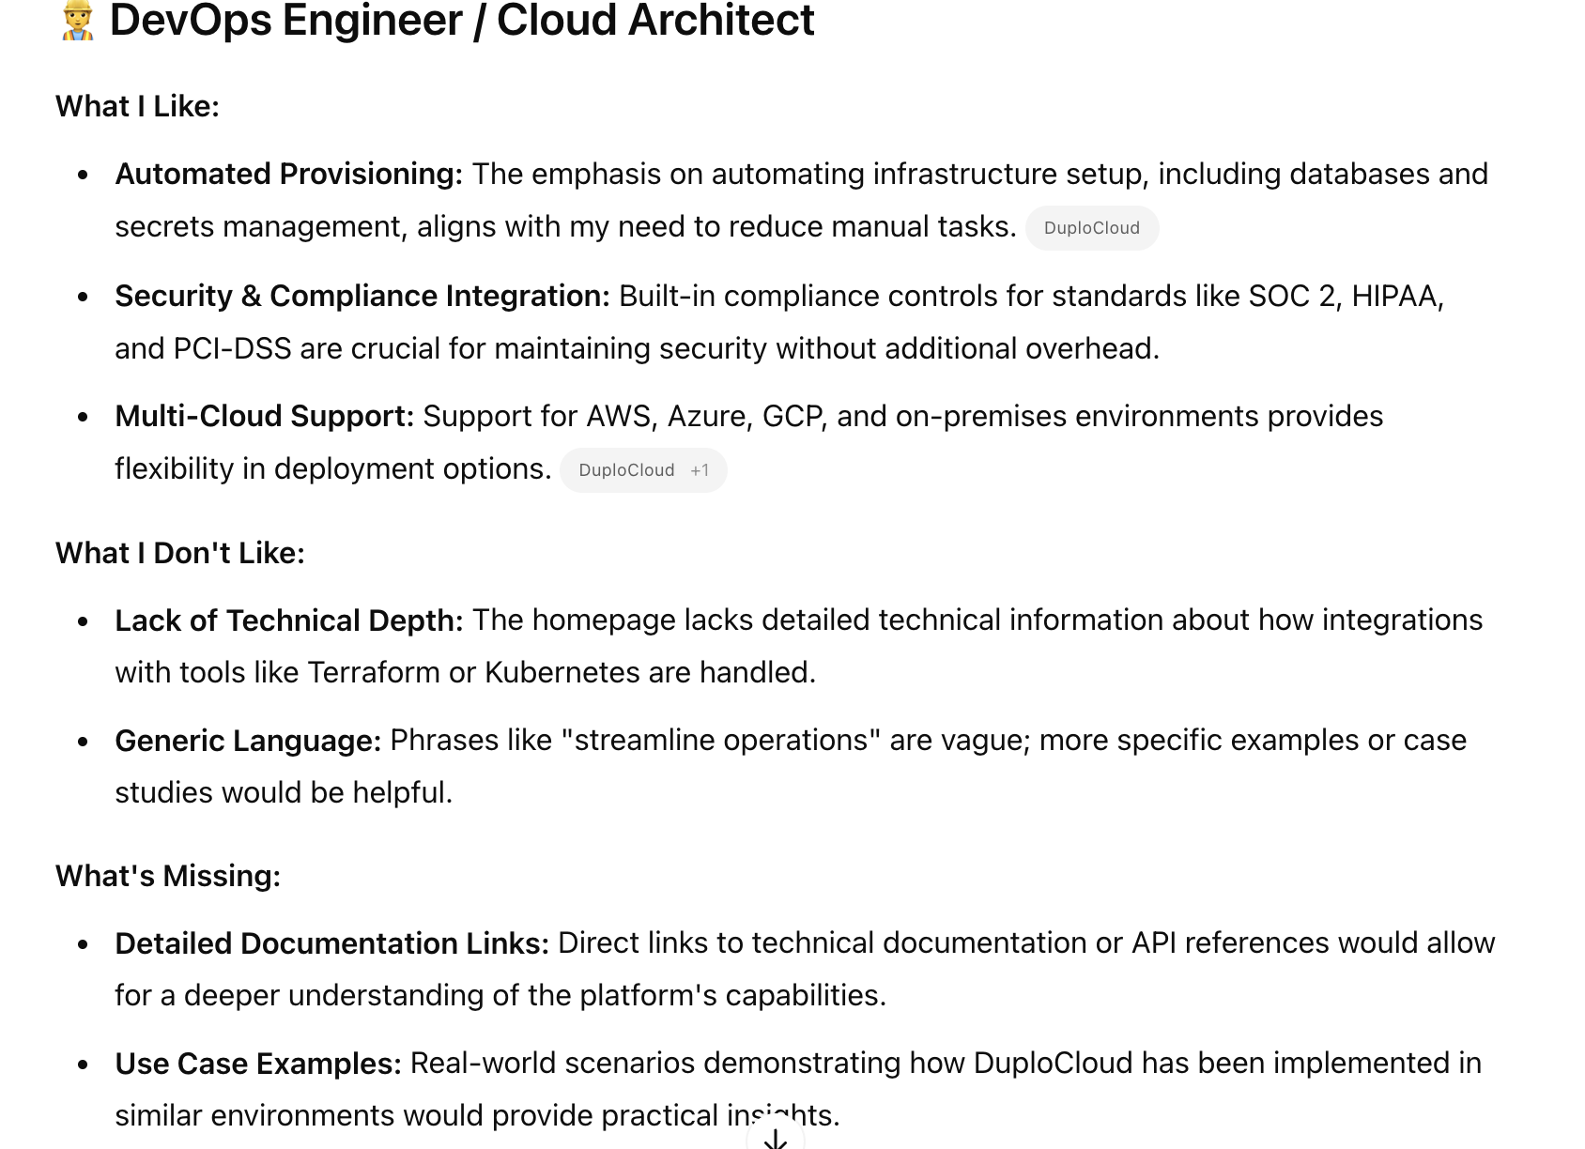
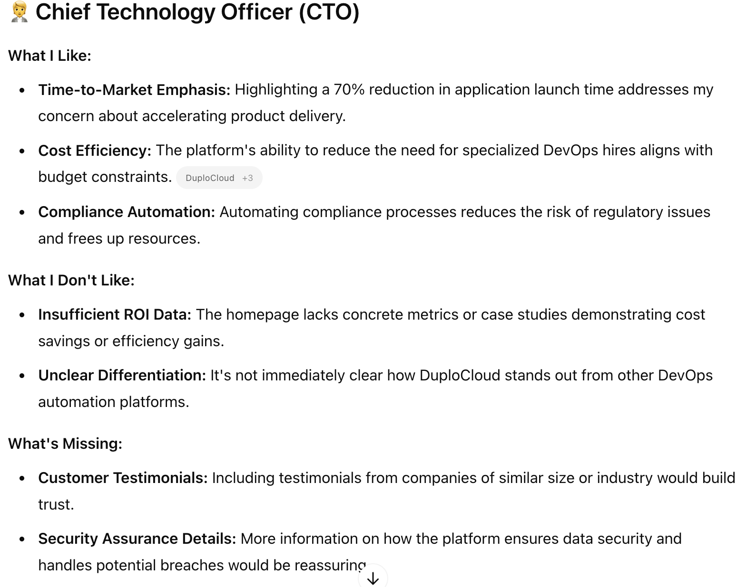
I asked each persona for information on a new homepage design …

Slide 11
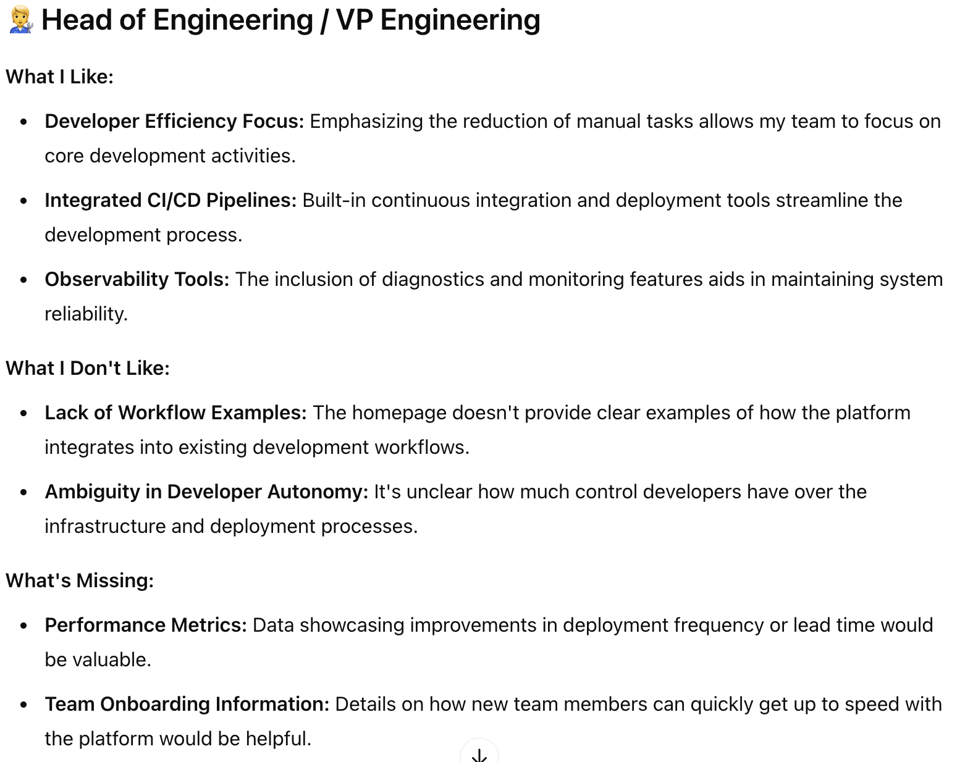
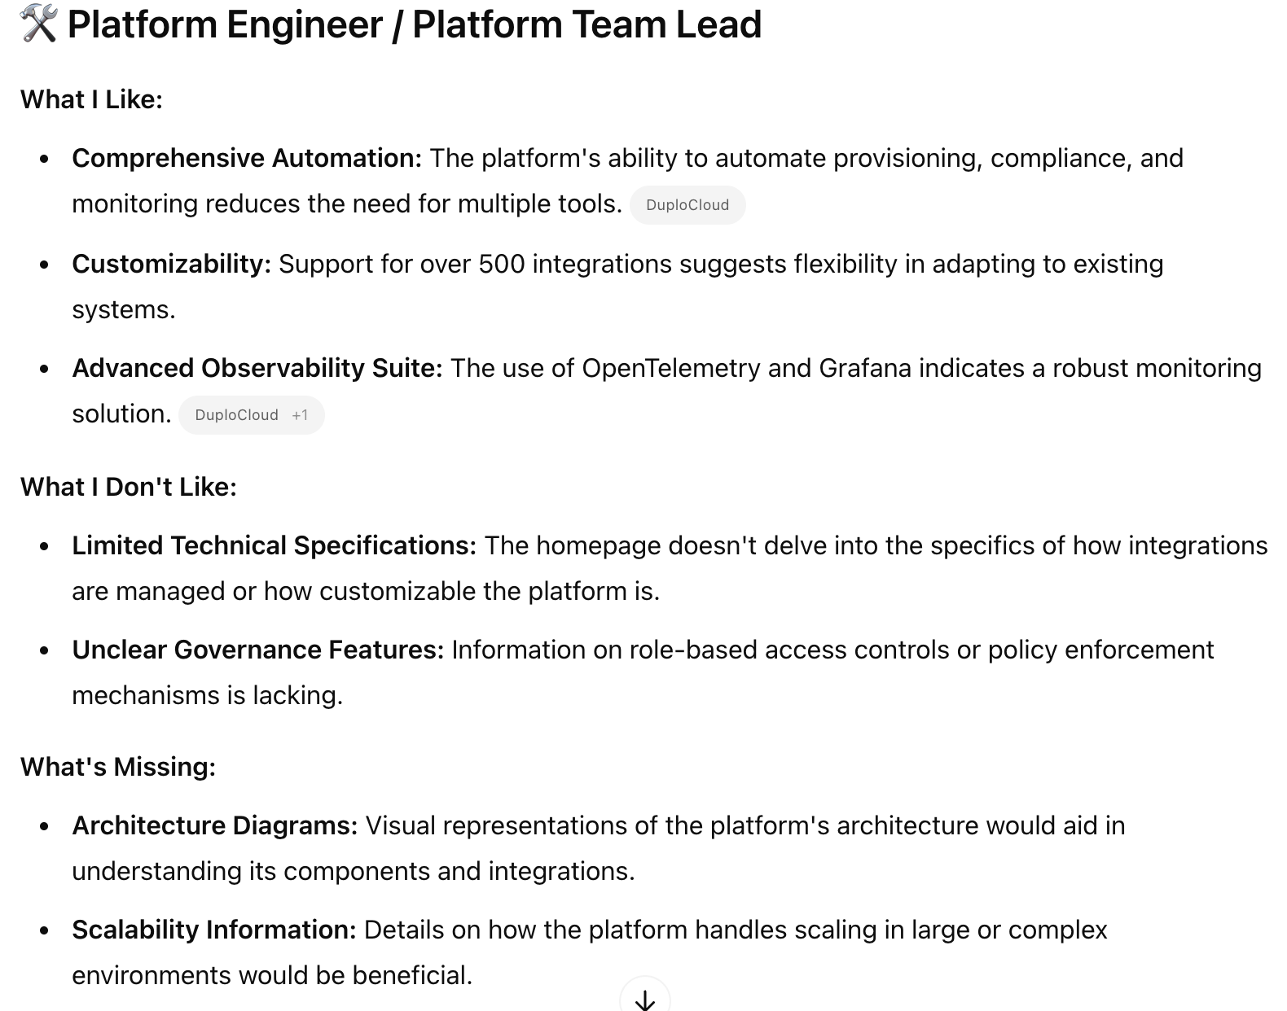
I asked each persona for information on a new homepage design …

Slide 12
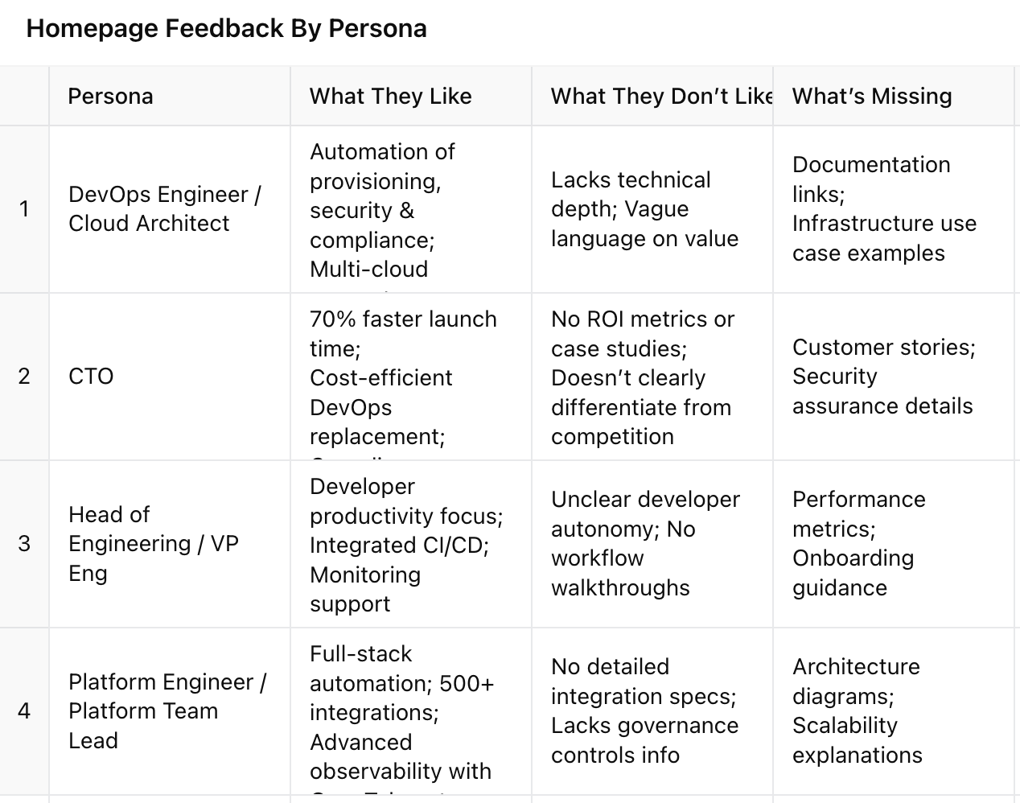
You can also just ask it to summarize in a table

Slide 13
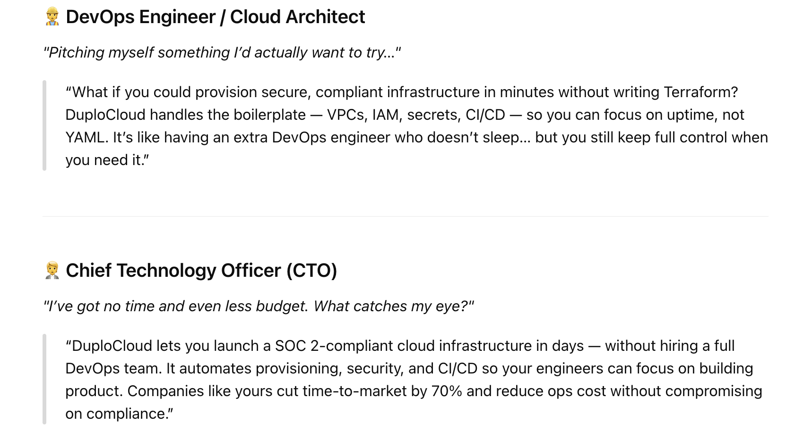
I asked the Agents to make their own pitches for my product…

Slide 14
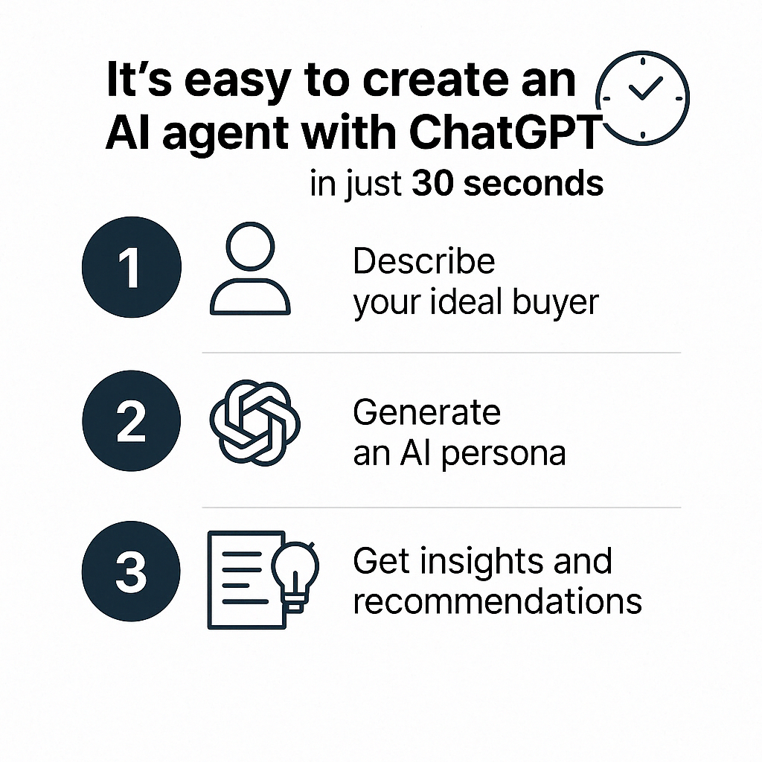
So how hard was this really?
That depends on how nuanced you want to be
My initial prototype took about 2 hours to create
I had a lot of data I was able to feed to ChatGPT
Key buyer personas and roles
Detailed breakdown of pain points, personality, industries, most likely state of their business at each stage, etc for each persona
Worked with my product marketing, sales and sales enablement team for all data

Slide 15
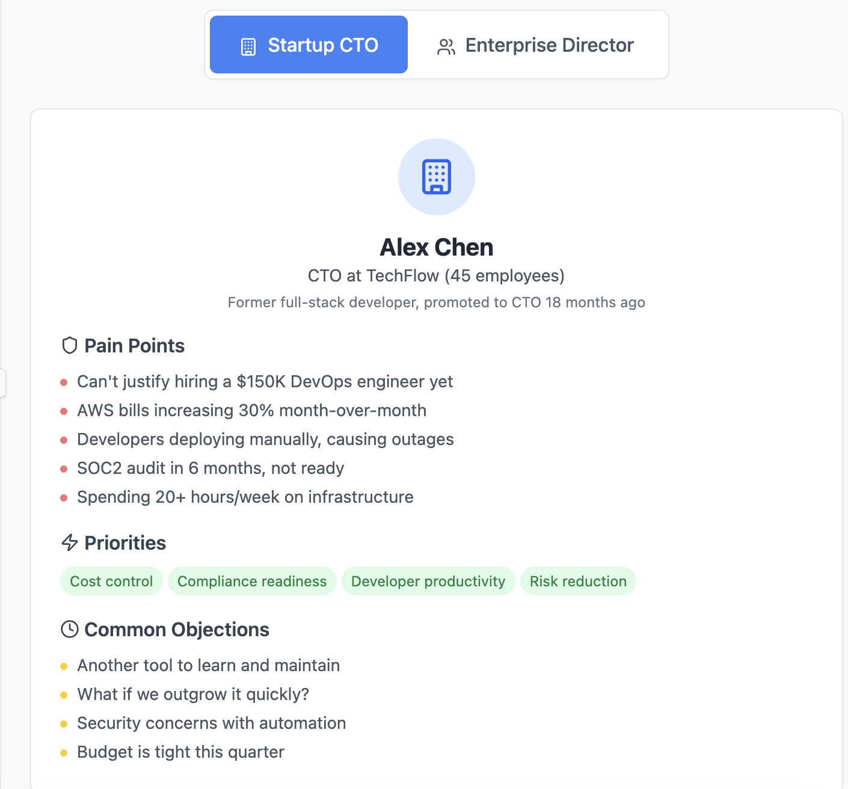
I also experimented with building in Anthropic
Different inputs
Initially wanted me to provide high level information on personas and asked for my website
Different outputs
Claude immediately created two separate personas (SMB & MM)
Personas came arrived with current situation and problems they needed solved

Slide 16
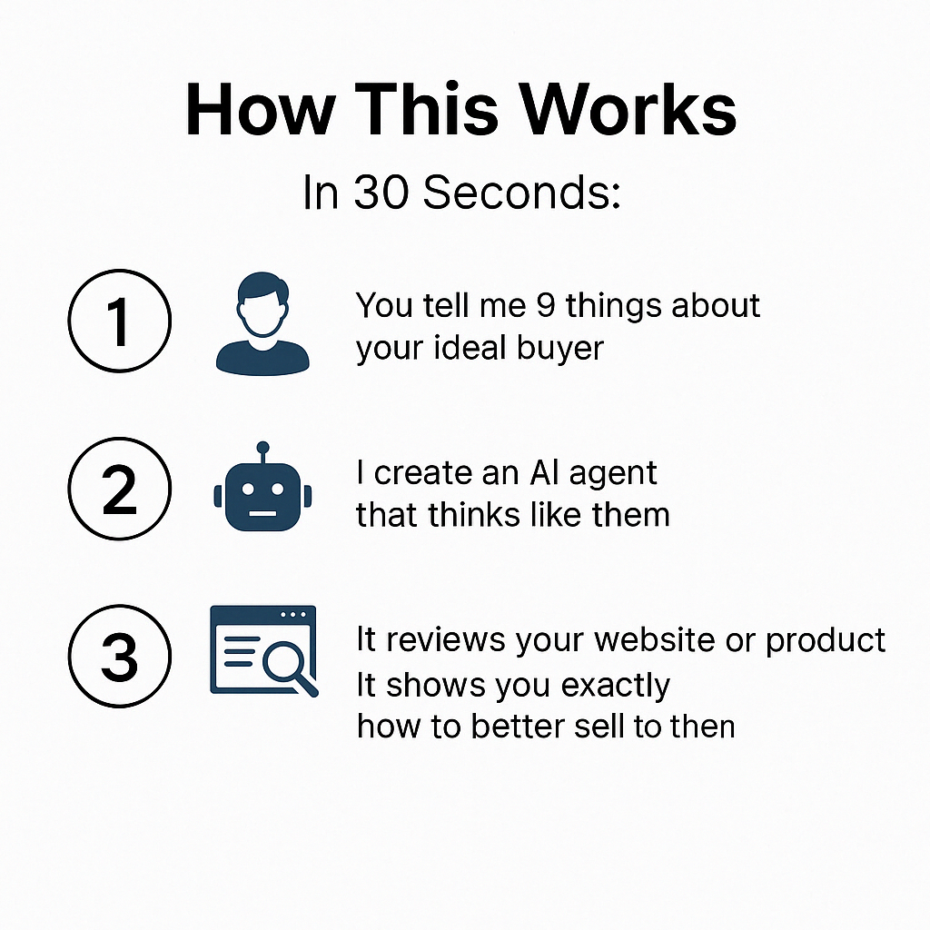
Let’s build an Agent RIGHT NOW (Link to questionnaire)
Once you give me your inputs, I’ll instantly build an AI agent that:
Talks and thinks like your real buyer — personality, goals, pain points, and all
Reviews your product or website like they would, pointing out what they like, dislike, and what’s missing
Tells you exactly what would get their attention — so you can fine-tune your messaging, your product positioning, or even your outbound campaigns
You’ll get a realistic, on-the-fly simulation of how your dream customer actually thinks and reacts."

Slide 17
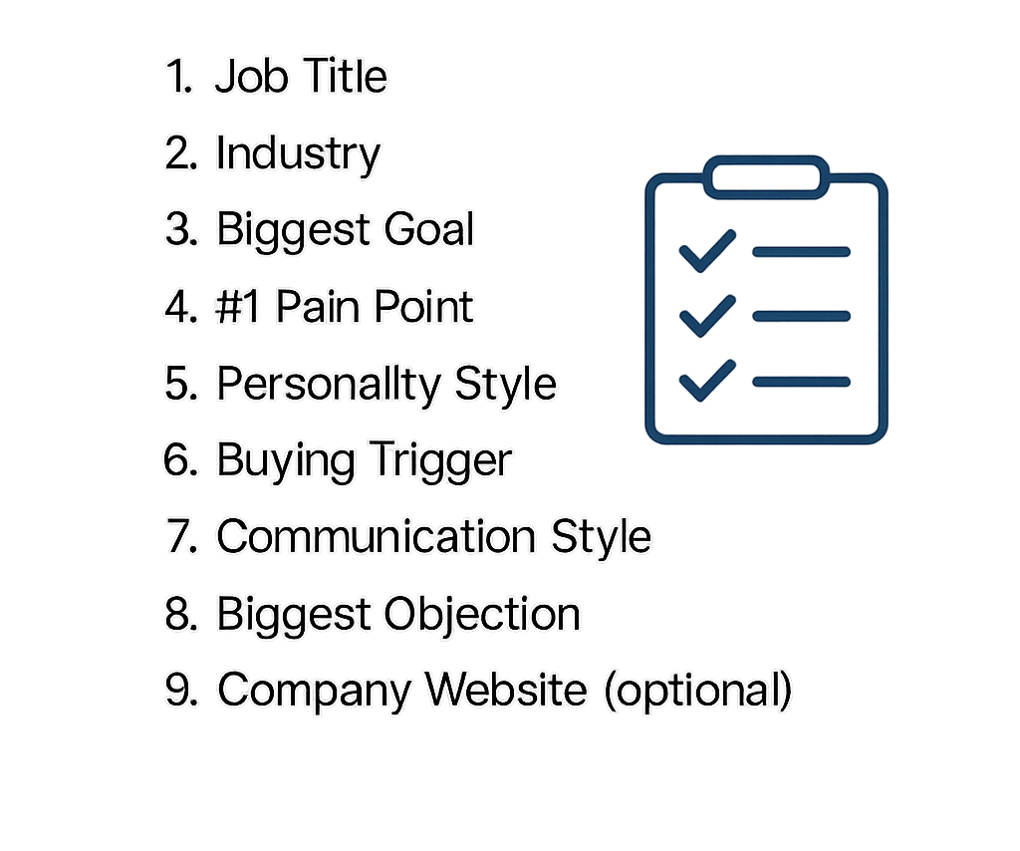
Here’s a cheatsheet to get started fast! LINK

Slide 18
For a more in-depth Agent you’ll want more inputs
CTOs (Chief Technology Officers)
Talent and Resource Constraints: CTOs at startups struggle to hire and retain enough skilled DevOps engineers – demand far exceeds supply (Common DevOps Challenges and How Service Providers Solve Them | by SmartCLOUD Australia | Mar, 2025 | Medium). Budgets are limited, so they often operate with a very lean ops team (or none at all). This puts pressure on the CTO (or developers) to handle cloud setup themselves, which isn’t scalable.
Slow Time-to-Market: Standing up a cloud infrastructure that is scalable and compliant can be painfully slow with limited resources. In regulated industries, even a modest environment can take multiple months to build properly with Infrastructure-as-Code (Automating 10x faster with low-code/no-code DevOps - DuploCloud). These delays directly impact the company’s ability to ship products and features.
Compliance and Security Risks: CTOs are acutely concerned with meeting standards like SOC 2, PCI-DSS, HIPAA, etc., especially when pursuing enterprise customers or handling sensitive data. Without dedicated DevSecOps staff, ensuring audit-ready compliance is a major pain point – e.g. preparing for a SOC 2 audit can divert engineering for weeks. Any security misconfiguration could have serious business consequences, so the CTO carries this risk.
Cost Efficiency: Small companies can ill afford large DevOps teams or expensive one-off fixes for cloud issues. CTOs worry about the total cost of managing cloud infrastructure – not just cloud bills, but the engineering hours spent on ops. The DIY approach might use “free” open-source tools, but the hidden cost is high in labor and potential downtime. They need a solution that is cost-effective and doesn’t require a lot of in-house maintenance.

Slide 19
Things to consider
Does your company have a corporate LLM account?
You don’t want to share sensitive data or IP with an LLM
You’ll want to democratize the usage of these agents
Slack integration or private access to your agents
Maintenance and continuous education
Supply your agents with fresh insights
Call transcripts from Gong
Data from surveys, NPS, reviews from G2, Gartner, TrustRadius
If you are purchasing research data (Nielsen, etc)
Consider purchasing older data and using it for your model. Request a deep discount.

Slide 20
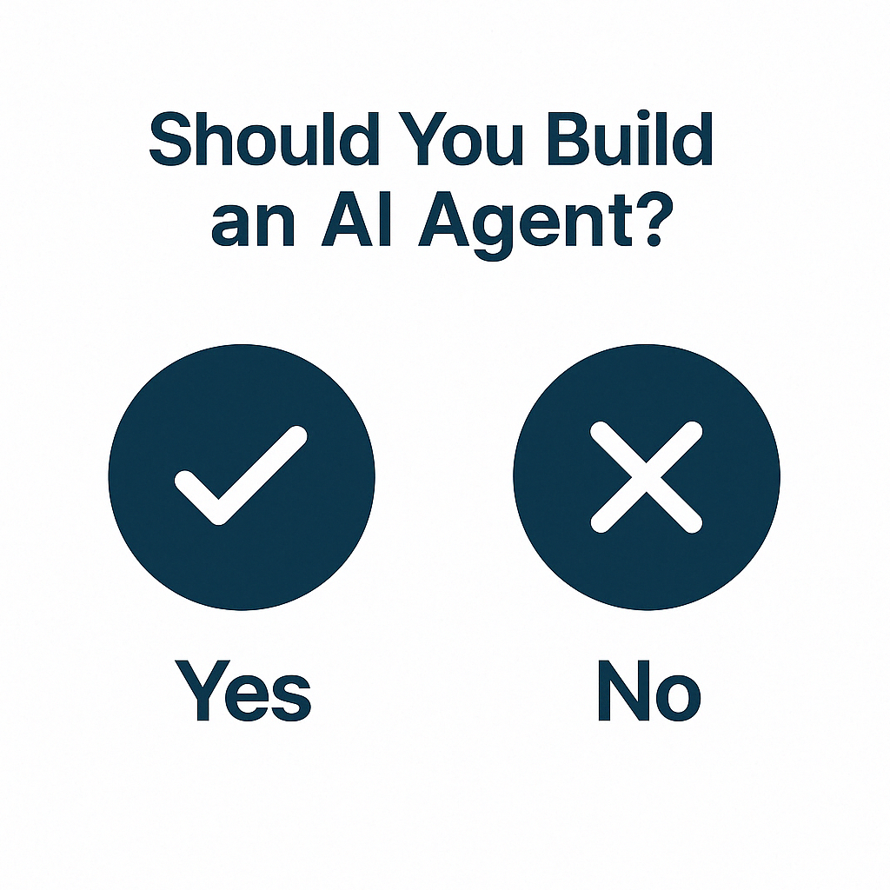
You don’t have to build an AI Agent
You can’t sit around and let other people out-execute you while you fall behind
AI is shockingly easy to use and it doesn’t always/often require you to purchase software
Let your imagination run and just go ask whatever GPT you use whether or not it can build something for you
It’s crazy what you can dream up, you just have to have the time, patience and creativity to do it

